Slide 1
All-Pairs Shortest Paths

Slide 2
All-Pairs Shortest Paths
We are given a weighted, directed graph G = (V, E) with a weight function w : E → ℝ that maps edges to real-valued weights. We wish to find, for every pair of nodes u, v ∈ V, a shortest (least-weight) path from u to v, where the weight of a path is the sum of the weights of its constituent edges. We typically want the output in tabular form: the entry in u’s row and v’s column should be the weight of a shortest path from u to v.
2
3
4
⎛
⎝
⎞
⎠
0 | 1 | −3 | 2 | −4
3 | 0 | −4 | 1 | −1
7 | 4 | 0 | 5 | 3
2 | −1 | −5 | 0 | −2
8 | 5 | 1 | 6 | 0
1
3
8
1
−4
2
−5
7
5
4
6

Slide 3
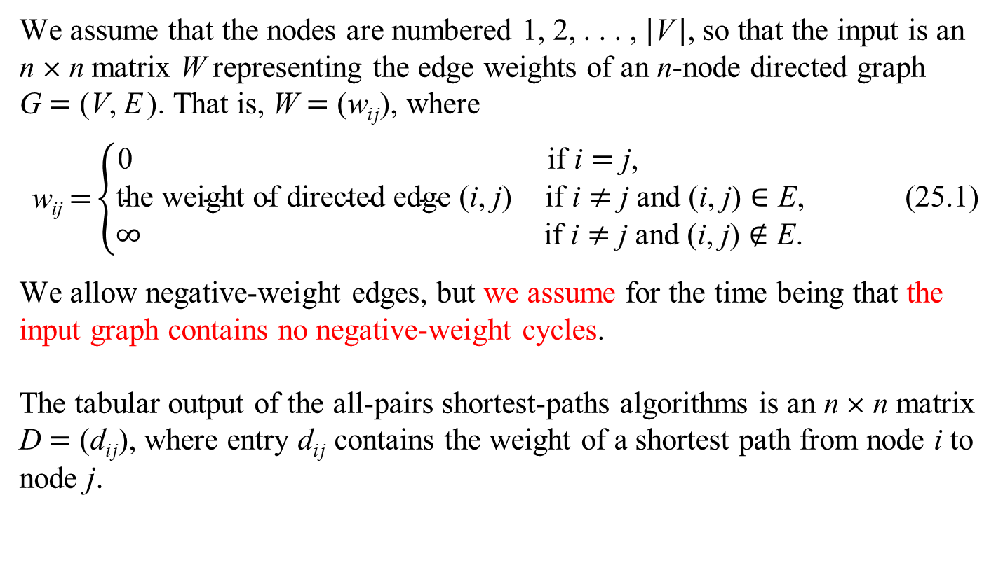
All-Pairs Shortest Paths
We assume that the nodes are numbered 1, 2, . . . , |V|, so that the input is an n × n matrix W representing the edge weights of an n-node directed graph G = (V, E). That is, W = (w_{ij}), where
$$\text{w}\text{ij} \text{=}\left\{\begin{matrix}\text{0} & \text{if} \text{i}=\text{j}\text{, } \\ \text{t}\text{he} \text{weight} \text{of} \text{d}\text{irecte}\text{d} \text{edge}\text{ (}\text{i}\text{,} \text{j}\text{)} & \text{if} \text{i}≠\text{j} \text{and}\text{ (}\text{i}\text{, }\text{j}\text{)}∈\text{E}\text{, (25.1)} \\ ∞ & \text{if} \text{i}≠\text{j} \text{and}\text{ (}\text{i}\text{, }\text{j}\text{)}∉\text{E}\text{. }\end{matrix}\right.$$
We allow negative-weight edges, but we assume for the time being that the input graph contains no negative-weight cycles.
The tabular output of the all-pairs shortest-paths algorithms is an n × n matrix D = (d_{ij}), where entry d_{ij} contains the weight of a shortest path from node i to node j.

Slide 4
All-Pairs Shortest Paths
2
3
4
⎛
⎝
⎞
⎠
0 | 3 | 8 | ∞ | −4
∞ | 0 | ∞ | 1 | 7
∞ | 4 | 0 | ∞ | ∞
2 | ∞ | −5 | 0 | ∞
∞ | ∞ | ∞ | 6 | 0
1
3
8
W =
1
−4
2
−5
7
5
4
6
⎛
⎝
⎞
⎠
⎛
⎝
⎞
⎠
NIL | 3 | 4 | 5 | 1
4 | NIL | 4 | 2 | 1
4 | 3 | NIL | 2 | 1
4 | 3 | 4 | NIL | 1
4 | 3 | 4 | 5 | NIL
0 | 1 | −3 | 2 | −4
3 | 0 | −4 | 1 | −1
7 | 4 | 0 | 5 | 3
2 | −1 | −5 | 0 | −2
8 | 5 | 1 | 6 | 0
Π =
D =

Slide 5
The Floyd-Warshall Algorithm

Slide 6
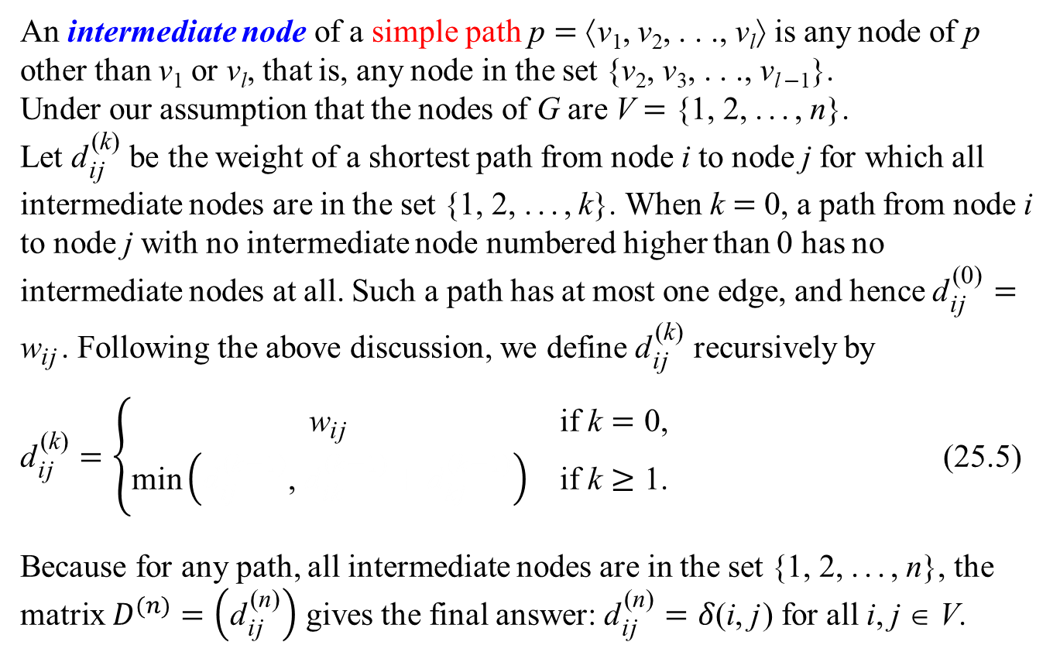
The Floyd-Warshall Algorithm
An intermediate node of a simple path p = ⟨v₁, v₂, . . ., v_{l}⟩ is any node of p other than v₁ or v_{l}, that is, any node in the set {v₂, v₃, . . ., v_{l−1}}.
Under our assumption that the nodes of G are V = {1, 2, ..., n}.
Let ${\text{d}}_{\text{i}\text{j}}^{ \text{(}\text{k}\text{)}}$ be the weight of a shortest path from node i to node j for which all intermediate nodes are in the set {1, 2, ..., k}. When k = 0, a path from node i to node j with no intermediate node numbered higher than 0 has no intermediate nodes at all. Such a path has at most one edge, and hence ${\text{d}}_{\text{i}\text{j}}^{ \text{(0)}}={\text{w}}_{\text{i}\text{j}}$. Following the above discussion, we define ${\text{d}}_{\text{i}\text{j}}^{ \text{(}\text{k}\text{)}}$ recursively by
${\text{d}}_{\text{i}\text{j}}^{ \text{(}\text{k}\text{)}}=\left\{\begin{matrix}{\text{w}}_{\text{i}\text{j}} & \text{if} \text{k}=\text{0}\text{,} \\ \text{min}\left({\text{d}}_{\text{i}\text{j}}^{ \text{(}\text{k}\text{−}\text{1}\text{)}}\text{, }{\text{d}}_{\text{i}\text{k}}^{ \text{(}\text{k}\text{−}\text{1}\text{)}}+{\text{d}}_{\text{k}\text{j}}^{ \text{(}\text{k}\text{−}\text{1}\text{)}}\right) & \text{if} \text{k}≥\text{1}\text{.}\end{matrix}\right.$ (25.5)
Because for any path, all intermediate nodes are in the set {1, 2, ..., n}, the matrix $D^{(n)}=\left({\text{d}}_{\text{i}\text{j}}^{ \text{(}\text{n}\text{)}}\right)$ gives the final answer: ${\text{d}}_{\text{i}\text{j}}^{ \text{(}\text{n}\text{)}}=δ\text{(}\text{i}\text{, }\text{j}\text{)}$ for all i, j ∈ V.

Slide 7
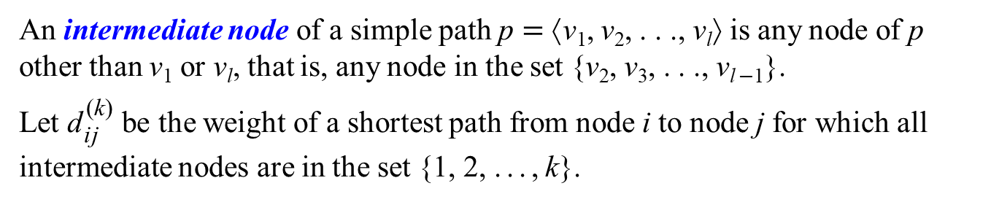
An intermediate node of a simple path p = ⟨v₁, v₂, . . ., v_{l}⟩ is any node of p other than v₁ or v_{l}, that is, any node in the set {v₂, v₃, . . ., v_{l−1}}.
Let ${\text{d}}_{\text{i}\text{j}}^{ \text{(}\text{k}\text{)}}$ be the weight of a shortest path from node i to node j for which all intermediate nodes are in the set {1, 2, ..., k}.
⎛
⎝
⎞
⎠
⎛
⎝
⎞
⎠
0 | 3 | 8 | ∞ | −4
∞ | 0 | ∞ | 1 | 7
∞ | 4 | 0 | ∞ | ∞
2 | ∞ | −5 | 0 | ∞
∞ | ∞ | ∞ | 6 | 0
0 | 3 | 8 | ∞ | −4
∞ | 0 | ∞ | 1 | 7
∞ | 4 | 0 | ∞ | ∞
2 | 5 | −5 | 0 | −2
∞ | ∞ | ∞ | 6 | 0
W =
D⁽¹⁾ =
2
3
4
⎛
⎝
⎞
⎠
0 | 3 | 8 | 4 | −4
∞ | 0 | ∞ | 1 | 7
∞ | 4 | 0 | 5 | 11
2 | 5 | −5 | 0 | −2
∞ | ∞ | ∞ | 6 | 0
1
3
8
D⁽²⁾ =
1
−4
2
−5
7
5
4
6

Slide 8

An intermediate node of a simple path p = ⟨v₁, v₂, . . ., v_{l}⟩ is any node of p other than v₁ or v_{l}, that is, any node in the set {v₂, v₃, . . ., v_{l−1}}.
Let ${\text{d}}_{\text{i}\text{j}}^{ \text{(}\text{k}\text{)}}$ be the weight of a shortest path from node i to node j for which all intermediate nodes are in the set {1, 2, ..., k}.
⎛
⎝
⎞
⎠
⎛
⎝
⎞
⎠
0 | 3 | 8 | ∞ | −4
∞ | 0 | ∞ | 1 | 7
∞ | 4 | 0 | ∞ | ∞
2 | ∞ | −5 | 0 | ∞
∞ | ∞ | ∞ | 6 | 0
0 | 3 | 8 | 4 | −4
∞ | 0 | ∞ | 1 | 7
∞ | 4 | 0 | 5 | 11
2 | 5 | −5 | 0 | −2
∞ | ∞ | ∞ | 6 | 0
W =
D⁽²⁾ =
2
3
4
⎛
⎝
⎞
⎠
0 | 3 | 8 | 4 | −4
∞ | 0 | ∞ | 1 | 7
∞ | 4 | 0 | 5 | 11
2 | −1 | −5 | 0 | −2
∞ | ∞ | ∞ | 6 | 0
1
3
8
D⁽³⁾ =
1
−4
2
−5
7
5
4
6

Slide 9
An intermediate node of a simple path p = ⟨v₁, v₂, . . ., v_{l}⟩ is any node of p other than v₁ or v_{l}, that is, any node in the set {v₂, v₃, . . ., v_{l−1}}.
Let ${\text{d}}_{\text{i}\text{j}}^{ \text{(}\text{k}\text{)}}$ be the weight of a shortest path from node i to node j for which all intermediate nodes are in the set {1, 2, ..., k}.
⎛
⎝
⎞
⎠
⎛
⎝
⎞
⎠
0 | 3 | 8 | ∞ | −4
∞ | 0 | ∞ | 1 | 7
∞ | 4 | 0 | ∞ | ∞
2 | ∞ | −5 | 0 | ∞
∞ | ∞ | ∞ | 6 | 0
0 | 3 | 8 | 4 | −4
∞ | 0 | ∞ | 1 | 7
∞ | 4 | 0 | 5 | 11
2 | −1 | −5 | 0 | −2
∞ | ∞ | ∞ | 6 | 0
W =
D⁽³⁾ =
2
3
4
⎛
⎝
⎞
⎠
0 | 3 | −1 | 4 | −4
3 | 0 | −4 | 1 | −1
7 | 4 | 0 | 5 | 3
2 | −1 | −5 | 0 | −2
8 | 5 | 1 | 6 | 0
1
3
8
D⁽⁴⁾ =
1
−4
2
−5
7
5
4
6

Slide 10
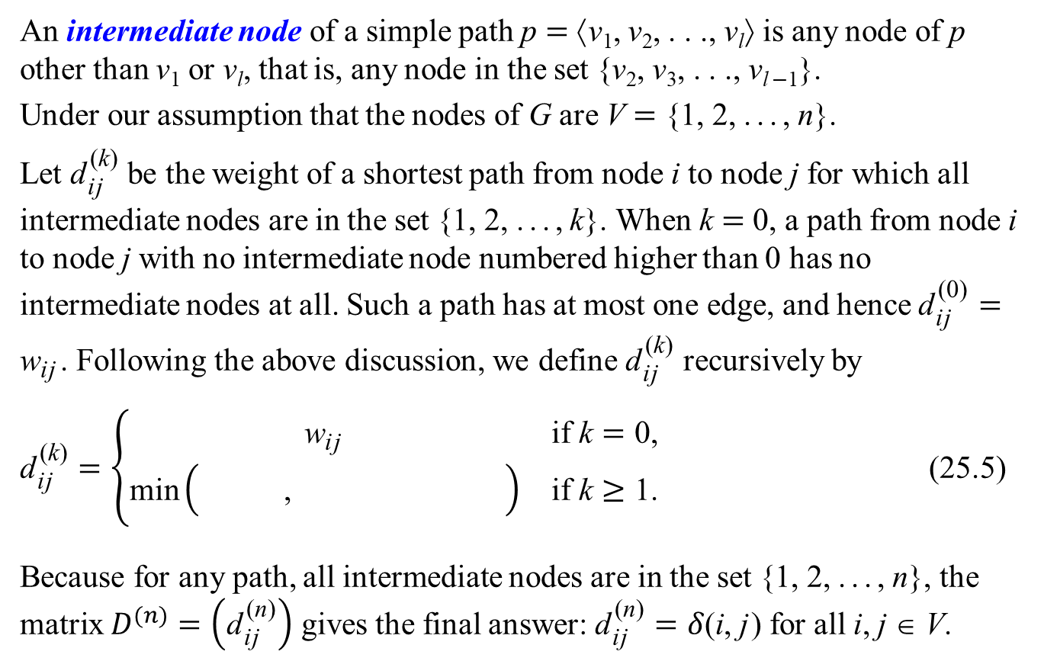
The Floyd-Warshall Algorithm
An intermediate node of a simple path p = ⟨v₁, v₂, . . ., v_{l}⟩ is any node of p other than v₁ or v_{l}, that is, any node in the set {v₂, v₃, . . ., v_{l−1}}.
Under our assumption that the nodes of G are V = {1, 2, ..., n}.
Let ${\text{d}}_{\text{i}\text{j}}^{ \text{(}\text{k}\text{)}}$ be the weight of a shortest path from node i to node j for which all intermediate nodes are in the set {1, 2, ..., k}. When k = 0, a path from node i to node j with no intermediate node numbered higher than 0 has no intermediate nodes at all. Such a path has at most one edge, and hence ${\text{d}}_{\text{i}\text{j}}^{ \text{(0)}}={\text{w}}_{\text{i}\text{j}}$. Following the above discussion, we define ${\text{d}}_{\text{i}\text{j}}^{ \text{(}\text{k}\text{)}}$ recursively by
${\text{d}}_{\text{i}\text{j}}^{ \text{(}\text{k}\text{)}}=\left\{\begin{matrix}{\text{w}}_{\text{i}\text{j}} & \text{if} \text{k}=\text{0}\text{,} \\ \text{min}\left({\text{d}}_{\text{i}\text{j}}^{ \text{(}\text{k}\text{−}\text{1}\text{)}}\text{, }{\text{d}}_{\text{i}\text{k}}^{ \text{(}\text{k}\text{−}\text{1}\text{)}}+{\text{d}}_{\text{k}\text{j}}^{ \text{(}\text{k}\text{−}\text{1}\text{)}}\right) & \text{if} \text{k}≥\text{1}\text{.}\end{matrix}\right.$ (25.5)
Because for any path, all intermediate nodes are in the set {1, 2, ..., n}, the matrix $D^{(n)}=\left({\text{d}}_{\text{i}\text{j}}^{ \text{(}\text{n}\text{)}}\right)$ gives the final answer: ${\text{d}}_{\text{i}\text{j}}^{ \text{(}\text{n}\text{)}}=δ\text{(}\text{i}\text{, }\text{j}\text{)}$ for all i, j ∈ V.

Slide 11
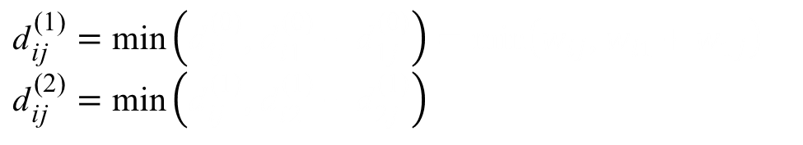
⎛
⎝
⎞
⎠
⎛
⎝
⎞
⎠
0 | 3 | 8 | ∞ | −4
∞ | 0 | ∞ | 1 | 7
∞ | 4 | 0 | ∞ | ∞
2 | ∞ | −5 | 0 | ∞
∞ | ∞ | ∞ | 6 | 0
0 | 3 | 8 | ∞ | −4
∞ | 0 | ∞ | 1 | 7
∞ | 4 | 0 | ∞ | ∞
2 | 5 | −5 | 0 | −2
∞ | ∞ | ∞ | 6 | 0
D⁽⁰⁾ =
D⁽¹⁾ =
⎛
⎝
⎞
⎠
⎛
⎝
⎞
⎠
0 | 3 | 8 | ∞ | −4
∞ | 0 | ∞ | 1 | 7
∞ | 4 | 0 | ∞ | ∞
2 | ∞ | −5 | 0 | ∞
∞ | ∞ | ∞ | 6 | 0
0 | 3 | 8 | 4 | −4
∞ | 0 | ∞ | 1 | 7
∞ | 4 | 0 | 5 | 11
2 | 5 | −5 | 0 | −2
∞ | ∞ | ∞ | 6 | 0
W =
D⁽²⁾ =
2
3
4
1
3
8
1
$${\text{d}}_{\text{i}\text{j}}^{ \text{(}\text{1}\text{)}}=\text{min}\left({\text{d}}_{\text{i}\text{j}}^{ \text{(0)}}\text{,} {\text{d}}_{\text{i}\text{1}}^{ \text{(0)}}+{\text{d}}_{\text{1}\text{j}}^{ \text{(0)}}\right)=\text{min}\left(w_{ij}\text{, }w_{i1}+w_{1j}\right)$$
$${\text{d}}_{\text{i}\text{j}}^{ \text{(}\text{2}\text{)}}=\text{min}\left({\text{d}}_{\text{i}\text{j}}^{ \text{(}\text{1}\text{)}}\text{, }{\text{d}}_{\text{i}\text{2}}^{ \text{(}\text{1}\text{)}}+{\text{d}}_{\text{2}\text{j}}^{ \text{(}\text{1}\text{)}}\right)$$
−4
2
−5
7
5
4
6

Slide 12
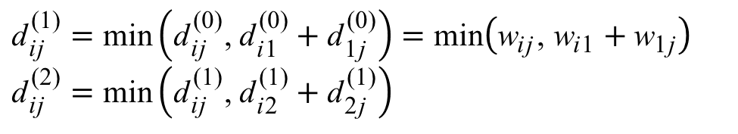
⎛
⎝
⎞
⎠
⎛
⎝
⎞
⎠
0 | 3 | 8 | ∞ | −4
∞ | 0 | ∞ | 1 | 7
∞ | 4 | 0 | ∞ | ∞
2 | ∞ | −5 | 0 | ∞
∞ | ∞ | ∞ | 6 | 0
0 | 3 | 8 | ∞ | −4
∞ | 0 | ∞ | 1 | 7
∞ | 4 | 0 | ∞ | ∞
2 | 5 | −5 | 0 | −2
∞ | ∞ | ∞ | 6 | 0
D⁽⁰⁾ =
D⁽¹⁾ =
⎛
⎝
⎞
⎠
⎛
⎝
⎞
⎠
0 | 3 | 8 | ∞ | −4
∞ | 0 | ∞ | 1 | 7
∞ | 4 | 0 | ∞ | ∞
2 | ∞ | −5 | 0 | ∞
∞ | ∞ | ∞ | 6 | 0
0 | 3 | 8 | 4 | −4
∞ | 0 | ∞ | 1 | 7
∞ | 4 | 0 | 5 | 11
2 | 5 | −5 | 0 | −2
∞ | ∞ | ∞ | 6 | 0
W =
D⁽²⁾ =
2
3
4
1
3
8
1
$${\text{d}}_{\text{i}\text{j}}^{ \text{(}\text{1}\text{)}}=\text{min}\left({\text{d}}_{\text{i}\text{j}}^{ \text{(0)}}\text{,} {\text{d}}_{\text{i}\text{1}}^{ \text{(0)}}+{\text{d}}_{\text{1}\text{j}}^{ \text{(0)}}\right)=\text{min}\left({\text{w}}_{\text{i}\text{j}}\text{,} {\text{w}}_{\text{i}\text{1}}+{\text{w}}_{\text{1}\text{j}}\right)$$
$${\text{d}}_{\text{i}\text{j}}^{ \text{(}\text{2}\text{)}}=\text{min}\left({\text{d}}_{\text{i}\text{j}}^{ \text{(}\text{1}\text{)}}\text{, }{\text{d}}_{\text{i}\text{2}}^{ \text{(}\text{1}\text{)}}+{\text{d}}_{\text{2}\text{j}}^{ \text{(}\text{1}\text{)}}\right)$$
−4
2
−5
7
5
4
6

Slide 13
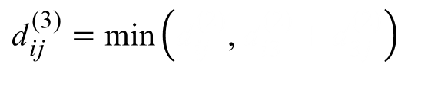
⎛
⎝
⎞
⎠
⎛
⎝
⎞
⎠
0 | 3 | 8 | ∞ | −4
∞ | 0 | ∞ | 1 | 7
∞ | 4 | 0 | ∞ | ∞
2 | ∞ | −5 | 0 | ∞
∞ | ∞ | ∞ | 6 | 0
0 | 3 | 8 | 4 | −4
∞ | 0 | ∞ | 1 | 7
∞ | 4 | 0 | 5 | 11
2 | −1 | −5 | 0 | −2
∞ | ∞ | ∞ | 6 | 0
D⁽⁰⁾ =
D⁽³⁾ =
⎛
⎝
⎞
⎠
⎛
⎝
⎞
⎠
0 | 3 | 8 | ∞ | −4
∞ | 0 | ∞ | 1 | 7
∞ | 4 | 0 | ∞ | ∞
2 | ∞ | −5 | 0 | ∞
∞ | ∞ | ∞ | 6 | 0
0 | 3 | 8 | 4 | −4
∞ | 0 | ∞ | 1 | 7
∞ | 4 | 0 | 5 | 11
2 | 5 | −5 | 0 | −2
∞ | ∞ | ∞ | 6 | 0
W =
D⁽²⁾ =
2
3
4
1
3
8
1
$${\text{d}}_{\text{i}\text{j}}^{ \text{(}\text{3}\text{)}}=\text{min}\left({\text{d}}_{\text{i}\text{j}}^{ \text{(}\text{2}\text{)}}\text{, }{\text{d}}_{\text{i}\text{3}}^{ \text{(}\text{2}\text{)}}+{\text{d}}_{\text{3}\text{j}}^{ \text{(}\text{2}\text{)}}\right)$$
−4
2
−5
7
5
4
6

Slide 14
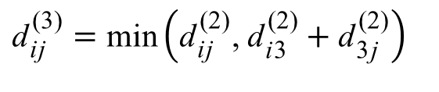
⎛
⎝
⎞
⎠
⎛
⎝
⎞
⎠
0 | 3 | 8 | ∞ | −4
∞ | 0 | ∞ | 1 | 7
∞ | 4 | 0 | ∞ | ∞
2 | ∞ | −5 | 0 | ∞
∞ | ∞ | ∞ | 6 | 0
0 | 3 | 8 | 4 | −4
∞ | 0 | ∞ | 1 | 7
∞ | 4 | 0 | 5 | 11
2 | −1 | −5 | 0 | −2
∞ | ∞ | ∞ | 6 | 0
D⁽⁰⁾ =
D⁽³⁾ =
⎛
⎝
⎞
⎠
⎛
⎝
⎞
⎠
0 | 3 | 8 | ∞ | −4
∞ | 0 | ∞ | 1 | 7
∞ | 4 | 0 | ∞ | ∞
2 | ∞ | −5 | 0 | ∞
∞ | ∞ | ∞ | 6 | 0
0 | 3 | 8 | 4 | −4
∞ | 0 | ∞ | 1 | 7
∞ | 4 | 0 | 5 | 11
2 | 5 | −5 | 0 | −2
∞ | ∞ | ∞ | 6 | 0
W =
D⁽²⁾ =
2
3
4
1
3
8
1
$${\text{d}}_{\text{i}\text{j}}^{ \text{(}\text{3}\text{)}}=\text{min}\left({\text{d}}_{\text{i}\text{j}}^{ \text{(}\text{2}\text{)}}\text{, }{\text{d}}_{\text{i}\text{3}}^{ \text{(}\text{2}\text{)}}+{\text{d}}_{\text{3}\text{j}}^{ \text{(}\text{2}\text{)}}\right)$$
−4
2
−5
7
5
4
6

Slide 15
The Floyd-Warshall Algorithm
An intermediate node of a simple path p = ⟨v₁, v₂, . . ., v_{l}⟩ is any node of p other than v₁ or v_{l}, that is, any node in the set {v₂, v₃, . . ., v_{l−1}}.
Under our assumption that the nodes of G are V = {1, 2, ..., n}.
Let ${\text{d}}_{\text{i}\text{j}}^{ \text{(}\text{k}\text{)}}$ be the weight of a shortest path from node i to node j for which all intermediate nodes are in the set {1, 2, ..., k}. When k = 0, a path from node i to node j with no intermediate node numbered higher than 0 has no intermediate nodes at all. Such a path has at most one edge, and hence ${\text{d}}_{\text{i}\text{j}}^{ \text{(0)}}={\text{w}}_{\text{i}\text{j}}$. Following the above discussion, we define ${\text{d}}_{\text{i}\text{j}}^{ \text{(}\text{k}\text{)}}$ recursively by
${\text{d}}_{\text{i}\text{j}}^{ \text{(}\text{k}\text{)}}=\left\{\begin{matrix}{\text{w}}_{\text{i}\text{j}} & \text{if} \text{k}=\text{0}\text{,} \\ \text{min}\left({\text{d}}_{\text{i}\text{j}}^{ \text{(}\text{k}\text{−}\text{1}\text{)}}\text{, }{\text{d}}_{\text{i}\text{k}}^{ \text{(}\text{k}\text{−}\text{1}\text{)}}+{\text{d}}_{\text{k}\text{j}}^{ \text{(}\text{k}\text{−}\text{1}\text{)}}\right) & \text{if} \text{k}≥\text{1}\text{.}\end{matrix}\right.$ (25.5)
Because for any path, all intermediate nodes are in the set {1, 2, ..., n}, the matrix $D^{(n)}=\left({\text{d}}_{\text{i}\text{j}}^{ \text{(}\text{n}\text{)}}\right)$ gives the final answer: ${\text{d}}_{\text{i}\text{j}}^{ \text{(}\text{n}\text{)}}=δ\text{(}\text{i}\text{, }\text{j}\text{)}$ for all i, j ∈ V.

Slide 16
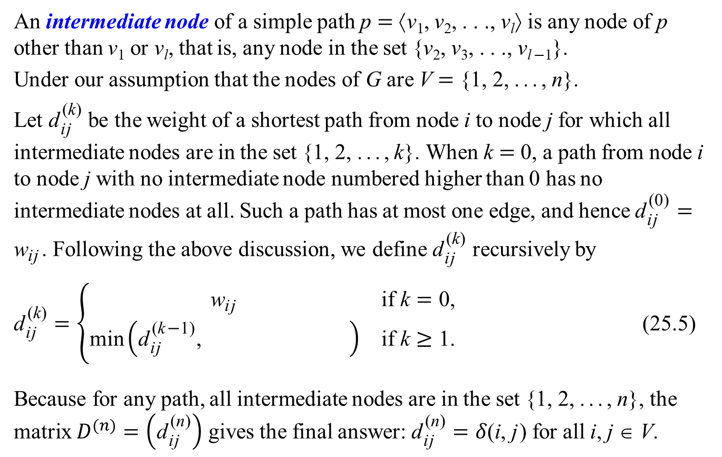
The Floyd-Warshall Algorithm
An intermediate node of a simple path p = ⟨v₁, v₂, . . ., v_{l}⟩ is any node of p other than v₁ or v_{l}, that is, any node in the set {v₂, v₃, . . ., v_{l−1}}.
Under our assumption that the nodes of G are V = {1, 2, ..., n}.
Let ${\text{d}}_{\text{i}\text{j}}^{ \text{(}\text{k}\text{)}}$ be the weight of a shortest path from node i to node j for which all intermediate nodes are in the set {1, 2, ..., k}. When k = 0, a path from node i to node j with no intermediate node numbered higher than 0 has no intermediate nodes at all. Such a path has at most one edge, and hence ${\text{d}}_{\text{i}\text{j}}^{ \text{(0)}}={\text{w}}_{\text{i}\text{j}}$. Following the above discussion, we define ${\text{d}}_{\text{i}\text{j}}^{ \text{(}\text{k}\text{)}}$ recursively by
${\text{d}}_{\text{i}\text{j}}^{ \text{(}\text{k}\text{)}}=\left\{\begin{matrix}{\text{w}}_{\text{i}\text{j}} & \text{if} \text{k}=\text{0}\text{,} \\ \text{min}\left({\text{d}}_{\text{i}\text{j}}^{ \text{(}\text{k}\text{−}\text{1}\text{)}}\text{, }{\text{d}}_{\text{i}\text{k}}^{ \text{(}\text{k}\text{−}\text{1}\text{)}}+{\text{d}}_{\text{k}\text{j}}^{ \text{(}\text{k}\text{−}\text{1}\text{)}}\right) & \text{if} \text{k}≥\text{1}\text{.}\end{matrix}\right.$ (25.5)
Because for any path, all intermediate nodes are in the set {1, 2, ..., n}, the matrix $D^{(n)}=\left({\text{d}}_{\text{i}\text{j}}^{ \text{(}\text{n}\text{)}}\right)$ gives the final answer: ${\text{d}}_{\text{i}\text{j}}^{ \text{(}\text{n}\text{)}}=δ\text{(}\text{i}\text{, }\text{j}\text{)}$ for all i, j ∈ V.

Slide 17
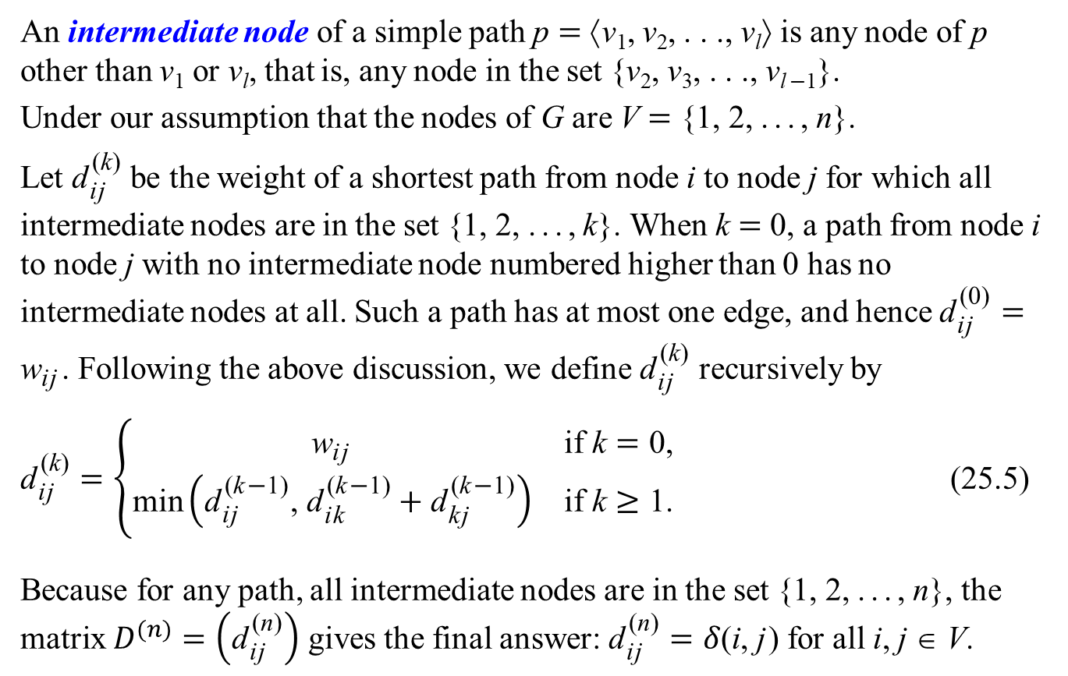
The Floyd-Warshall Algorithm
An intermediate node of a simple path p = ⟨v₁, v₂, . . ., v_{l}⟩ is any node of p other than v₁ or v_{l}, that is, any node in the set {v₂, v₃, . . ., v_{l−1}}.
Under our assumption that the nodes of G are V = {1, 2, ..., n}.
Let ${\text{d}}_{\text{i}\text{j}}^{ \text{(}\text{k}\text{)}}$ be the weight of a shortest path from node i to node j for which all intermediate nodes are in the set {1, 2, ..., k}. When k = 0, a path from node i to node j with no intermediate node numbered higher than 0 has no intermediate nodes at all. Such a path has at most one edge, and hence ${\text{d}}_{\text{i}\text{j}}^{ \text{(0)}}={\text{w}}_{\text{i}\text{j}}$. Following the above discussion, we define ${\text{d}}_{\text{i}\text{j}}^{ \text{(}\text{k}\text{)}}$ recursively by
${\text{d}}_{\text{i}\text{j}}^{ \text{(}\text{k}\text{)}}=\left\{\begin{matrix}{\text{w}}_{\text{i}\text{j}} & \text{if} \text{k}=\text{0}\text{,} \\ \text{min}\left({\text{d}}_{\text{i}\text{j}}^{ \text{(}\text{k}\text{−}\text{1}\text{)}}\text{, }{\text{d}}_{\text{i}\text{k}}^{ \text{(}\text{k}\text{−}\text{1}\text{)}}+{\text{d}}_{\text{k}\text{j}}^{ \text{(}\text{k}\text{−}\text{1}\text{)}}\right) & \text{if} \text{k}≥\text{1}\text{.}\end{matrix}\right.$ (25.5)
Because for any path, all intermediate nodes are in the set {1, 2, ..., n}, the matrix $D^{(n)}=\left({\text{d}}_{\text{i}\text{j}}^{ \text{(}\text{n}\text{)}}\right)$ gives the final answer: ${\text{d}}_{\text{i}\text{j}}^{ \text{(}\text{n}\text{)}}=δ\text{(}\text{i}\text{, }\text{j}\text{)}$ for all i, j ∈ V.

Slide 18
The Floyd-Warshall Algorithm
all intermediate nodes in {1, 2, ..., k−1}
all intermediate nodes in {1, 2, ..., k−1}
p: all intermediate nodes in {1, 2, ..., k}
Figure 25.3 Path p is a shortest path from node i to node j, and k is the highest-numbered intermediate node of p. Path p₁, the portion of path p from node i to node k, has all intermediate nodes in the set {1, 2, ..., k−1}. The same holds for path p₂ from node k to node j.

Slide 19
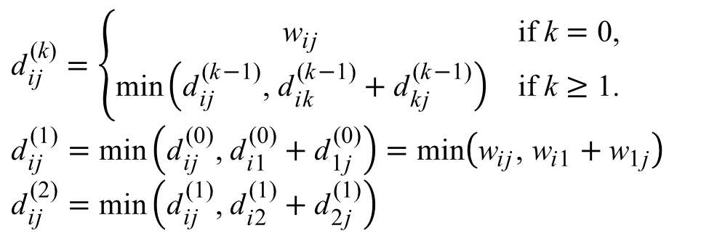
⎛
⎝
⎞
⎠
⎛
⎝
⎞
⎠
0 | 3 | 8 | ∞ | −4
∞ | 0 | ∞ | 1 | 7
∞ | 4 | 0 | ∞ | ∞
2 | ∞ | −5 | 0 | ∞
∞ | ∞ | ∞ | 6 | 0
0 | 3 | 8 | ∞ | −4
∞ | 0 | ∞ | 1 | 7
∞ | 4 | 0 | ∞ | ∞
2 | 5 | −5 | 0 | −2
∞ | ∞ | ∞ | 6 | 0
D⁽⁰⁾ =
D⁽¹⁾ =
⎛
⎝
⎞
⎠
⎛
⎝
⎞
⎠
0 | 3 | 8 | ∞ | −4
∞ | 0 | ∞ | 1 | 7
∞ | 4 | 0 | ∞ | ∞
2 | ∞ | −5 | 0 | ∞
∞ | ∞ | ∞ | 6 | 0
0 | 3 | 8 | 4 | −4
∞ | 0 | ∞ | 1 | 7
∞ | 4 | 0 | 5 | 11
2 | 5 | −5 | 0 | −2
∞ | ∞ | ∞ | 6 | 0
W =
D⁽²⁾ =
2
3
4
1
3
$${\text{d}}_{\text{i}\text{j}}^{ \text{(}\text{k}\text{)}}=\left\{\begin{matrix}{\text{w}}_{\text{i}\text{j}} & \text{if} \text{k}=\text{0,} \\ \text{min}\left({\text{d}}_{\text{i}\text{j}}^{ \text{(}\text{k}\text{−}\text{1}\text{)}}\text{, }{\text{d}}_{\text{i}\text{k}}^{ \text{(}\text{k}\text{−}\text{1}\text{)}}+{\text{d}}_{\text{k}\text{j}}^{ \text{(}\text{k}\text{−}\text{1}\text{)}}\right) & \text{if} \text{k}≥\text{1}\text{.}\end{matrix}\right.$$
$${\text{d}}_{\text{i}\text{j}}^{ \text{(}\text{1}\text{)}}=\text{min}\left({\text{d}}_{\text{i}\text{j}}^{ \text{(}\text{0}\text{)}}\text{, }{\text{d}}_{\text{i}\text{1}}^{ \text{(0)}}+{\text{d}}_{\text{1}\text{j}}^{ \text{(0)}}\right)=\text{min}\left({\text{w}}_{\text{i}\text{j}}\text{, }{\text{w}}_{\text{i}\text{1}}+{\text{w}}_{\text{1}\text{j}}\right)$$
$${\text{d}}_{\text{i}\text{j}}^{ \text{(}\text{2}\text{)}}=\text{min}\left({\text{d}}_{\text{i}\text{j}}^{ \text{(1)}}\text{,} {\text{d}}_{\text{i}\text{2}}^{ \text{(}\text{1}\text{)}}+{\text{d}}_{\text{2}\text{j}}^{ \text{(}\text{1}\text{)}}\right)$$
8
1
−4
2
−5
7
5
4
6

Slide 20
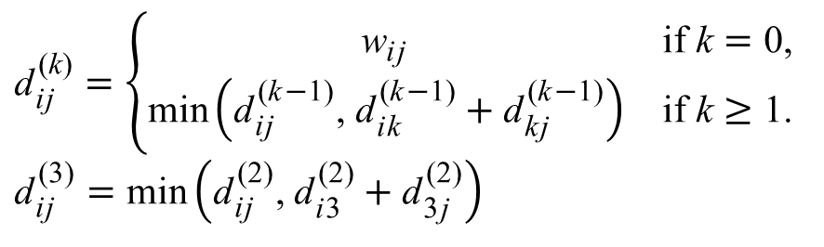
⎛
⎝
⎞
⎠
⎛
⎝
⎞
⎠
0 | 3 | 8 | ∞ | −4
∞ | 0 | ∞ | 1 | 7
∞ | 4 | 0 | ∞ | ∞
2 | ∞ | −5 | 0 | ∞
∞ | ∞ | ∞ | 6 | 0
0 | 3 | 8 | 4 | −4
∞ | 0 | ∞ | 1 | 7
∞ | 4 | 0 | 5 | 11
2 | −1 | −5 | 0 | −2
∞ | ∞ | ∞ | 6 | 0
D⁽⁰⁾ =
D⁽³⁾ =
⎛
⎝
⎞
⎠
⎛
⎝
⎞
⎠
0 | 3 | 8 | ∞ | −4
∞ | 0 | ∞ | 1 | 7
∞ | 4 | 0 | ∞ | ∞
2 | ∞ | −5 | 0 | ∞
∞ | ∞ | ∞ | 6 | 0
0 | 3 | 8 | 4 | −4
∞ | 0 | ∞ | 1 | 7
∞ | 4 | 0 | 5 | 11
2 | 5 | −5 | 0 | −2
∞ | ∞ | ∞ | 6 | 0
W =
D⁽²⁾ =
2
3
4
1
3
8
$${\text{d}}_{\text{i}\text{j}}^{ \text{(}\text{k}\text{)}}=\left\{\begin{matrix}{\text{w}}_{\text{i}\text{j}} & \text{if} \text{k}=\text{0,} \\ \text{min}\left({\text{d}}_{\text{i}\text{j}}^{ \text{(}\text{k}\text{−}\text{1}\text{)}}\text{, }{\text{d}}_{\text{i}\text{k}}^{ \text{(}\text{k}\text{−}\text{1}\text{)}}+{\text{d}}_{\text{k}\text{j}}^{ \text{(}\text{k}\text{−}\text{1}\text{)}}\right) & \text{if} \text{k}≥\text{1}\text{.}\end{matrix}\right.$$
$${\text{d}}_{\text{i}\text{j}}^{ \text{(}\text{3}\text{)}}=\text{min}\left({\text{d}}_{\text{i}\text{j}}^{ \text{(}\text{2}\text{)}}\text{, }{\text{d}}_{\text{i}\text{3}}^{ \text{(}\text{2}\text{)}}+{\text{d}}_{\text{3}\text{j}}^{ \text{(}\text{2}\text{)}}\right)$$
1
−4
2
−5
7
5
4
6

Slide 21
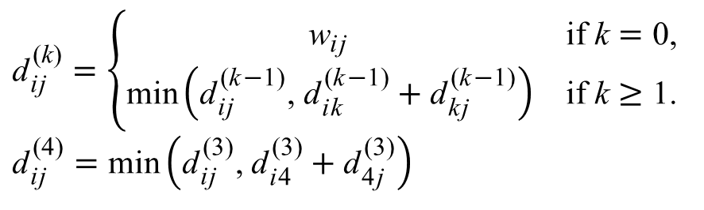
⎛
⎝
⎞
⎠
⎛
⎝
⎞
⎠
0 | 3 | 8 | ∞ | −4
∞ | 0 | ∞ | 1 | 7
∞ | 4 | 0 | ∞ | ∞
2 | ∞ | −5 | 0 | ∞
∞ | ∞ | ∞ | 6 | 0
0 | 3 | 8 | 4 | −4
∞ | 0 | ∞ | 1 | 7
∞ | 4 | 0 | 5 | 11
2 | −1 | −5 | 0 | −2
∞ | ∞ | ∞ | 6 | 0
D⁽⁰⁾ =
D⁽³⁾ =
⎛
⎝
⎞
⎠
⎛
⎝
⎞
⎠
0 | 3 | 8 | ∞ | −4
∞ | 0 | ∞ | 1 | 7
∞ | 4 | 0 | ∞ | ∞
2 | ∞ | −5 | 0 | ∞
∞ | ∞ | ∞ | 6 | 0
0 | 3 | −1 | 4 | −4
3 | 0 | −4 | 1 | −1
7 | 4 | 0 | 5 | 3
2 | −1 | −5 | 0 | −2
8 | 5 | 1 | 6 | 0
W =
D⁽⁴⁾ =
2
3
4
1
3
8
$${\text{d}}_{\text{i}\text{j}}^{ \text{(}\text{k}\text{)}}=\left\{\begin{matrix}{\text{w}}_{\text{i}\text{j}} & \text{if} \text{k}=\text{0,} \\ \text{min}\left({\text{d}}_{\text{i}\text{j}}^{ \text{(}\text{k}\text{−}\text{1}\text{)}}\text{, }{\text{d}}_{\text{i}\text{k}}^{ \text{(}\text{k}\text{−}\text{1}\text{)}}+{\text{d}}_{\text{k}\text{j}}^{ \text{(}\text{k}\text{−}\text{1}\text{)}}\right) & \text{if} \text{k}≥\text{1}\text{.}\end{matrix}\right.$$
$${\text{d}}_{\text{i}\text{j}}^{ \text{(}\text{4}\text{)}}=\text{min}\left({\text{d}}_{\text{i}\text{j}}^{ \text{(}\text{3}\text{)}}\text{, }{\text{d}}_{\text{i}\text{4}}^{ \text{(}\text{3}\text{)}}+{\text{d}}_{\text{4}\text{j}}^{ \text{(}\text{3}\text{)}}\right)$$
1
−4
2
−5
7
5
4
6

Slide 22
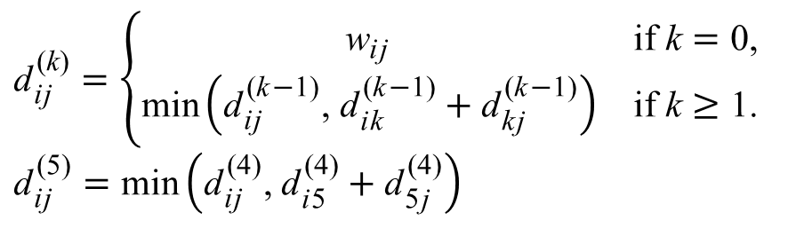
⎛
⎝
⎞
⎠
⎛
⎝
⎞
⎠
0 | 3 | 8 | ∞ | −4
∞ | 0 | ∞ | 1 | 7
∞ | 4 | 0 | ∞ | ∞
2 | ∞ | −5 | 0 | ∞
∞ | ∞ | ∞ | 6 | 0
0 | 1 | −3 | 2 | −4
3 | 0 | −4 | 1 | −1
7 | 4 | 0 | 5 | 3
2 | −1 | −5 | 0 | −2
8 | 5 | 1 | 6 | 0
D⁽⁰⁾ =
D⁽⁵⁾ =
⎛
⎝
⎞
⎠
⎛
⎝
⎞
⎠
0 | 3 | 8 | ∞ | −4
∞ | 0 | ∞ | 1 | 7
∞ | 4 | 0 | ∞ | ∞
2 | ∞ | −5 | 0 | ∞
∞ | ∞ | ∞ | 6 | 0
0 | 3 | −1 | 4 | −4
3 | 0 | −4 | 1 | −1
7 | 4 | 0 | 5 | 3
2 | −1 | −5 | 0 | −2
8 | 5 | 1 | 6 | 0
W =
D⁽⁴⁾ =
2
3
4
1
3
8
$${\text{d}}_{\text{i}\text{j}}^{ \text{(}\text{k}\text{)}}=\left\{\begin{matrix}{\text{w}}_{\text{i}\text{j}} & \text{if} \text{k}=\text{0,} \\ \text{min}\left({\text{d}}_{\text{i}\text{j}}^{ \text{(}\text{k}\text{−}\text{1}\text{)}}\text{, }{\text{d}}_{\text{i}\text{k}}^{ \text{(}\text{k}\text{−}\text{1}\text{)}}+{\text{d}}_{\text{k}\text{j}}^{ \text{(}\text{k}\text{−}\text{1}\text{)}}\right) & \text{if} \text{k}≥\text{1}\text{.}\end{matrix}\right.$$
$${\text{d}}_{\text{i}\text{j}}^{ \text{(}\text{5}\text{)}}=\text{min}\left({\text{d}}_{\text{i}\text{j}}^{ \text{(}\text{4}\text{)}}\text{, }{\text{d}}_{\text{i}\text{5}}^{ \text{(}\text{4}\text{)}}+{\text{d}}_{\text{5}\text{j}}^{ \text{(}\text{4}\text{)}}\right)$$
1
−4
2
−5
7
5
4
6

Slide 23
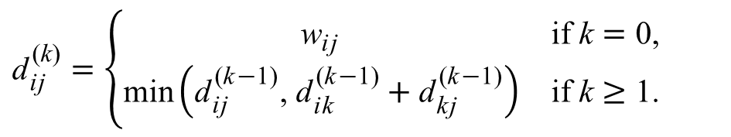
The Floyd-Warshall Algorithm
void FloydWarshall( int n )
{
for( int i = 1; i <= n; i++ )
for( int j = 1; j <= n; j++ )
d[0][i][j] = w[i][j];
for( int k = 1; k <= n; k++ )
for( int i = 1; i <= n; i++ )
for( int j = 1; j <= n; j++ )
d[k][i][j] = min( d[k-1][i][j],
d[k-1][i][k] + d[k-1][k][j] );
}
$${\text{d}}_{\text{i}\text{j}}^{ \text{(}\text{k}\text{)}}=\left\{\begin{matrix}{\text{w}}_{\text{i}\text{j}} & \text{if} \text{k}=\text{0,} \\ \text{min}\left({\text{d}}_{\text{i}\text{j}}^{ \text{(}\text{k}\text{−}\text{1}\text{)}}\text{, }{\text{d}}_{\text{i}\text{k}}^{ \text{(}\text{k}\text{−}\text{1}\text{)}}+{\text{d}}_{\text{k}\text{j}}^{ \text{(}\text{k}\text{−}\text{1}\text{)}}\right) & \text{if} \text{k}≥\text{1}\text{.}\end{matrix}\right.$$

Slide 24
The Floyd-Warshall Algorithm
void FloydWarshall( int n )
{
for( int i = 1; i <= n; i++ )
for( int j = 1; j <= n; j++ )
d[0][i][j] = w[i][j];
for( int k = 1; k <= n; k++ )
for( int i = 1; i <= n; i++ )
for( int j = 1; j <= n; j++ )
d[k][i][j] = min( d[k-1][i][j],
d[k-1][i][k] + d[k-1][k][j] );
}
$${\text{d}}_{\text{i}\text{j}}^{ \text{(}\text{k}\text{)}}=\left\{\begin{matrix}{\text{w}}_{\text{i}\text{j}} & \text{if} \text{k}=\text{0,} \\ \text{min}\left({\text{d}}_{\text{i}\text{j}}^{ \text{(}\text{k}\text{−}\text{1}\text{)}}\text{, }{\text{d}}_{\text{i}\text{k}}^{ \text{(}\text{k}\text{−}\text{1}\text{)}}+{\text{d}}_{\text{k}\text{j}}^{ \text{(}\text{k}\text{−}\text{1}\text{)}}\right) & \text{if} \text{k}≥\text{1}\text{.}\end{matrix}\right.$$

Slide 25
The Floyd-Warshall Algorithm
void FloydWarshall( int n )
{
for( int i = 1; i <= n; i++ )
for( int j = 1; j <= n; j++ )
d[i][j] = w[i][j];
for( int k = 1; k <= n; k++ )
for( int i = 1; i <= n; i++ )
for( int j = 1; j <= n; j++ )
d[i][j] = min( d[i][j], d[i][k] + d[k][j] );
}
$${\text{d}}_{\text{i}\text{j}}^{ \text{(}\text{k}\text{)}}=\left\{\begin{matrix}{\text{w}}_{\text{i}\text{j}} & \text{if} \text{k}=\text{0,} \\ \text{min}\left({\text{d}}_{\text{i}\text{j}}^{ \text{(}\text{k}\text{−}\text{1}\text{)}}\text{, }{\text{d}}_{\text{i}\text{k}}^{ \text{(}\text{k}\text{−}\text{1}\text{)}}+{\text{d}}_{\text{k}\text{j}}^{ \text{(}\text{k}\text{−}\text{1}\text{)}}\right) & \text{if} \text{k}≥\text{1}\text{.}\end{matrix}\right.$$

Slide 26
⎛
⎝
⎞
⎠
0 | 3 | −1 | 4 | −4
3 | 0 | −4 | 1 | −1
7 | 4 | 0 | 5 | 3
2 | −1 | −5 | 0 | −2
8 | 5 | 1 | 6 | 0
2
3
4
D⁽⁴⁾ =
1
3
8
1
−4
2
−5
7
⎛
⎝
⎞
⎠
5
4
0 | 1 | −3 | 2 | −4
3 | 0 | −4 | 1 | −1
7 | 4 | 0 | 5 | 3
2 | −1 | −5 | 0 | −2
8 | 5 | 1 | 6 | 0
6
D⁽⁵⁾ =
for( int k = 1; k <= n; k++ )
for( int i = 1; i <= n; i++ )
for( int j = 1; j <= n; j++ )
d[k][i][j] = min( d[k-1][i][j],
d[k-1][i][k] + d[k-1][k][j] );

Slide 27
⎛
⎝
⎞
⎠
0 | 3 | 8 | 4 | −4
∞ | 0 | ∞ | 1 | 7
∞ | 4 | 0 | 5 | 11
2 | 5 | −5 | 0 | −2
∞ | ∞ | ∞ | 6 | 0
2
3
4
D⁽²⁾ =
1
3
8
1
−4
2
−5
7
⎛
⎝
⎞
⎠
5
4
0 | 3 | 8 | 4 | −4
∞ | 0 | ∞ | 1 | 7
∞ | 4 | 0 | 5 | 11
2 | −1 | −5 | 0 | −2
∞ | ∞ | ∞ | 6 | 0
6
D⁽³⁾ =
for( int k = 1; k <= n; k++ )
for( int i = 1; i <= n; i++ )
for( int j = 1; j <= n; j++ )
d[k][i][j] = min( d[k-1][i][j],
d[k-1][i][k] + d[k-1][k][j] );

Slide 28
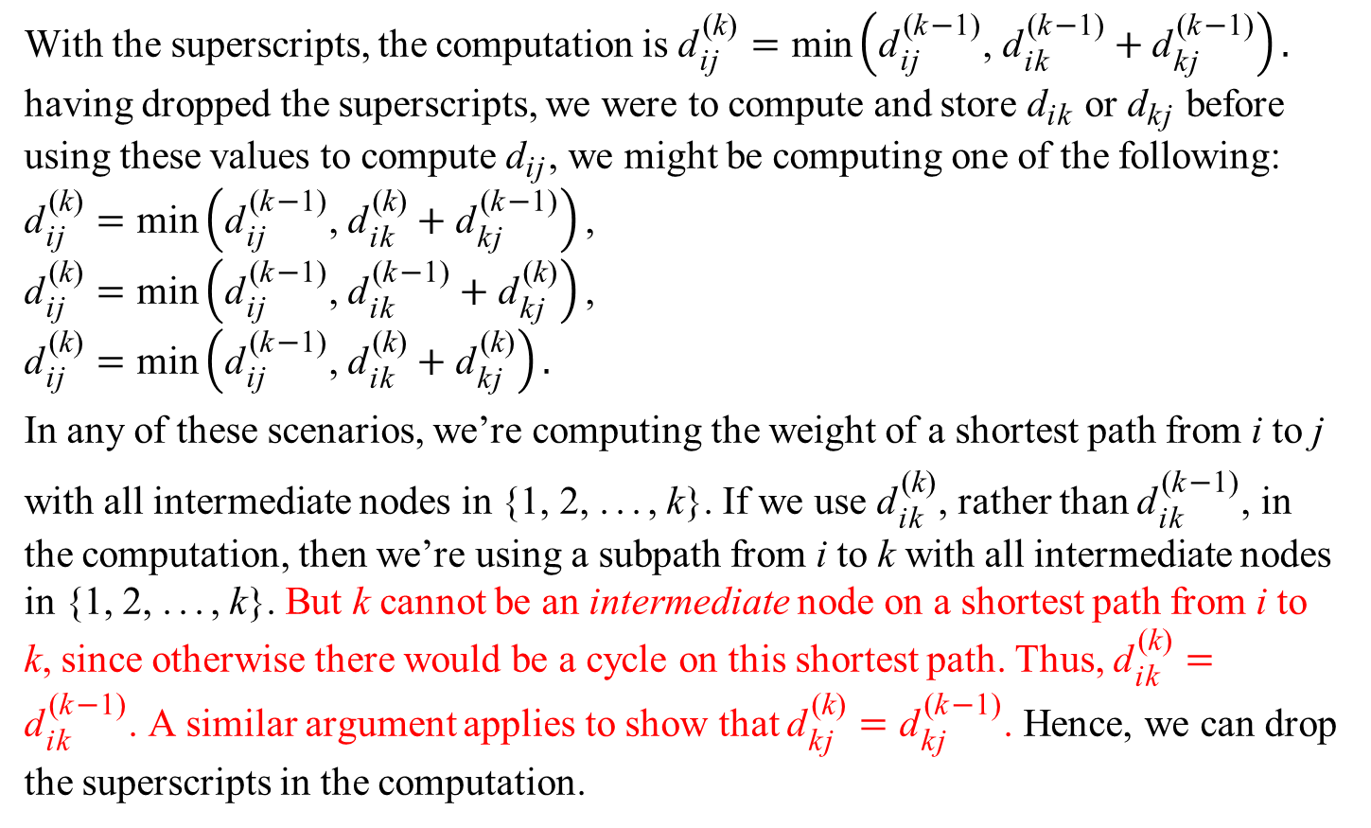
The Floyd-Warshall Algorithm is Correct
With the superscripts, the computation is ${\text{d}}_{\text{i}\text{j}}^{ \text{(}\text{k}\text{)}}=\text{min}\left({\text{d}}_{\text{i}\text{j}}^{ \text{(}\text{k}\text{−}\text{1}\text{)}}\text{, }{\text{d}}_{\text{i}\text{k}}^{ \text{(}\text{k}\text{−}\text{1}\text{)}}+{\text{d}}_{\text{k}\text{j}}^{ \text{(}\text{k}\text{−}\text{1}\text{)}}\right).$ having dropped the superscripts, we were to compute and store ${\text{d}}_{\text{i}\text{k}}$ or ${\text{d}}_{\text{k}\text{j}}$ before using these values to compute ${\text{d}}_{\text{i}\text{j}}$, we might be computing one of the following:
$${\text{d}}_{\text{i}\text{j}}^{ \text{(}\text{k}\text{)}}=\text{min}\left({\text{d}}_{\text{i}\text{j}}^{ \text{(}\text{k}\text{−}\text{1}\text{)}}\text{, }{\text{d}}_{\text{i}\text{k}}^{ \text{(}\text{k}\text{)}}+{\text{d}}_{\text{k}\text{j}}^{ \text{(}\text{k}\text{−}\text{1}\text{)}}\right)\text{,}$$
$${\text{d}}_{\text{i}\text{j}}^{ \text{(}\text{k}\text{)}}=\text{min}\left({\text{d}}_{\text{i}\text{j}}^{ \text{(}\text{k}\text{−}\text{1}\text{)}}\text{, }{\text{d}}_{\text{i}\text{k}}^{ \text{(}\text{k}\text{−}\text{1}\text{)}}+{\text{d}}_{\text{k}\text{j}}^{ \text{(}\text{k}\text{)}}\right)\text{,}$$
$${\text{d}}_{\text{i}\text{j}}^{ \text{(}\text{k}\text{)}}=\text{min}\left({\text{d}}_{\text{i}\text{j}}^{ \text{(}\text{k}\text{−}\text{1}\text{)}}\text{, }{\text{d}}_{\text{i}\text{k}}^{ \text{(}\text{k}\text{)}}+{\text{d}}_{\text{k}\text{j}}^{ \text{(}\text{k}\text{)}}\right).$$
In any of these scenarios, we’re computing the weight of a shortest path from i to j
with all intermediate nodes in {1, 2, ..., k}. If we use ${\text{d}}_{\text{i}\text{k}}^{ \text{(}\text{k}\text{)}}$, rather than ${\text{d}}_{\text{i}\text{k}}^{ \text{(}\text{k}\text{−}\text{1}\text{)}}$, in the computation, then we’re using a subpath from i to k with all intermediate nodes in {1, 2, ..., k}. But k cannot be an intermediate node on a shortest path from i to k, since otherwise there would be a cycle on this shortest path. Thus, ${\text{d}}_{\text{i}\text{k}}^{ \text{(}\text{k}\text{)}}={\text{d}}_{\text{i}\text{k}}^{ \text{(}\text{k}\text{−}\text{1}\text{)}}$. A similar argument applies to show that ${\text{d}}_{\text{kj}}^{ \text{(}\text{k}\text{)}}={\text{d}}_{\text{kj}}^{ \text{(}\text{k}\text{−}\text{1}\text{)}}$. Hence, we can drop the superscripts in the computation.

Slide 29
The Floyd-Warshall Algorithm
The time complexity of the Floyd-Warshall algorithm is determined by the triply
nested for loops. The algorithm runs in time Θ(n³).

Slide 30
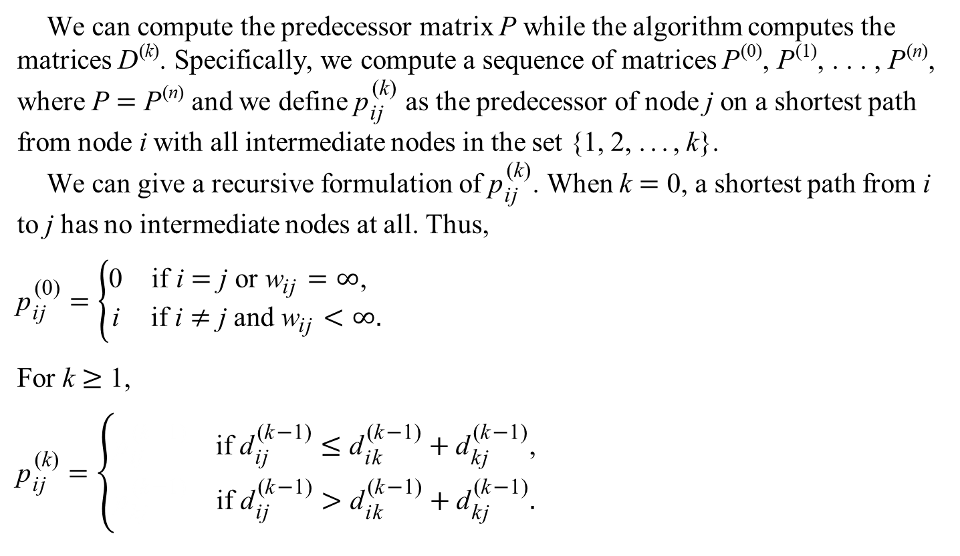
Constructing a Shortest Path
We can compute the predecessor matrix P while the algorithm computes the matrices D^{(k)}. Specifically, we compute a sequence of matrices P⁽⁰⁾, P⁽¹⁾, . . . , P^{(n)}, where P = P^{(n)} and we define ${\text{p}}_{\text{i}\text{j}}^{ \text{(}\text{k}\text{)}}$ as the predecessor of node j on a shortest path from node i with all intermediate nodes in the set {1, 2, ..., k}.
We can give a recursive formulation of ${\text{p}}_{\text{i}\text{j}}^{ \text{(}\text{k}\text{)}}$. When k = 0, a shortest path from i to j has no intermediate nodes at all. Thus,
$${\text{p}}_{\text{i}\text{j}}^{ \text{(}\text{0}\text{)}}=\left\{\begin{matrix}\text{0} & \text{if} \text{i}=\text{j} \text{or} {\text{w}}_{\text{i}\text{j}}=∞\text{, } \\ \text{i} & \text{if} \text{i}≠\text{j} \text{and} {\text{w}}_{\text{i}\text{j}}<∞.\end{matrix}\right.$$
For k ≥ 1,
$${\text{p}}_{\text{i}\text{j}}^{ \text{(}\text{k}\text{)}}=\left\{\begin{matrix}{\text{p}}_{\text{i}\text{j}}^{ \text{(}\text{k}\text{−}\text{1}\text{)}} & \text{if} {\text{d}}_{\text{i}\text{j}}^{ \text{(}\text{k}\text{−}\text{1}\text{)}}≤{\text{d}}_{\text{i}\text{k}}^{ \text{(}\text{k}\text{−}\text{1}\text{)}}+{\text{d}}_{\text{k}\text{j}}^{ \text{(}\text{k}\text{−}\text{1}\text{)}}\text{,} \\ {\text{p}}_{\text{k}\text{j}}^{ \text{(}\text{k}\text{−}\text{1}\text{)}} & \text{if} {\text{d}}_{\text{i}\text{j}}^{ \text{(}\text{k}\text{−}\text{1}\text{)}}>{\text{d}}_{\text{i}\text{k}}^{ \text{(}\text{k}\text{−}\text{1}\text{)}}+{\text{d}}_{\text{k}\text{j}}^{ \text{(}\text{k}\text{−}\text{1}\text{)}}.\end{matrix}\right.$$

Slide 31
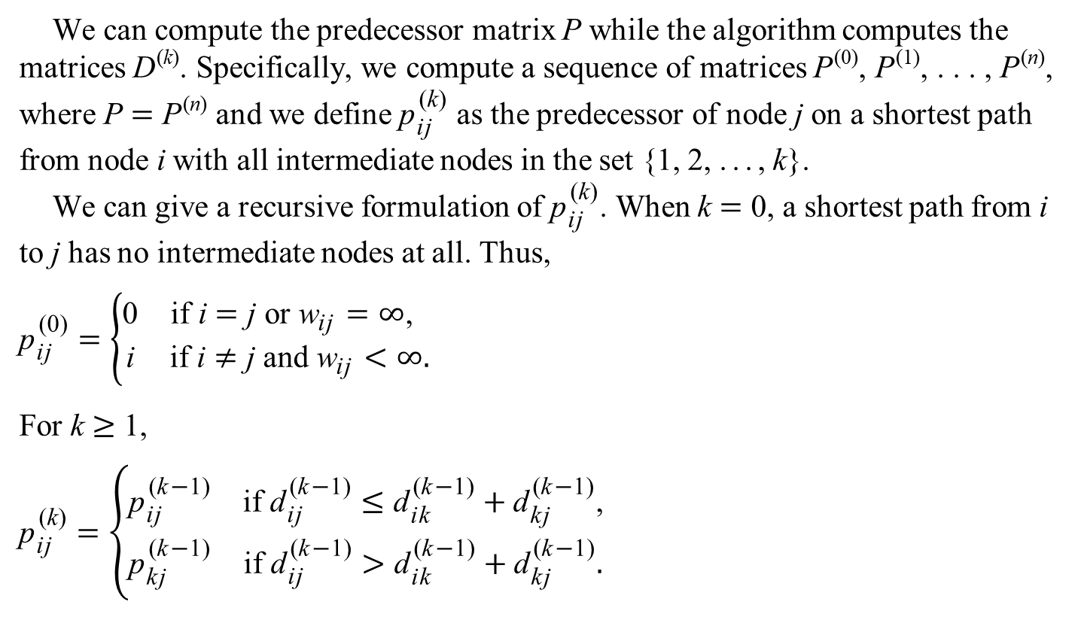
Constructing a Shortest Path
We can compute the predecessor matrix P while the algorithm computes the matrices D^{(k)}. Specifically, we compute a sequence of matrices P⁽⁰⁾, P⁽¹⁾, . . . , P^{(n)}, where P = P^{(n)} and we define ${\text{p}}_{\text{i}\text{j}}^{ \text{(}\text{k}\text{)}}$ as the predecessor of node j on a shortest path from node i with all intermediate nodes in the set {1, 2, ..., k}.
We can give a recursive formulation of ${\text{p}}_{\text{i}\text{j}}^{ \text{(}\text{k}\text{)}}$. When k = 0, a shortest path from i to j has no intermediate nodes at all. Thus,
$${\text{p}}_{\text{i}\text{j}}^{ \text{(}\text{0}\text{)}}=\left\{\begin{matrix}\text{0} & \text{if} \text{i}=\text{j} \text{or} {\text{w}}_{\text{i}\text{j}}=∞\text{, } \\ \text{i} & \text{if} \text{i}≠\text{j} \text{and} {\text{w}}_{\text{i}\text{j}}<∞.\end{matrix}\right.$$
For k ≥ 1,
$${\text{p}}_{\text{i}\text{j}}^{ \text{(}\text{k}\text{)}}=\left\{\begin{matrix}{\text{p}}_{\text{i}\text{j}}^{ \text{(}\text{k}\text{−}\text{1}\text{)}} & \text{if} {\text{d}}_{\text{i}\text{j}}^{ \text{(}\text{k}\text{−}\text{1}\text{)}}≤{\text{d}}_{\text{i}\text{k}}^{ \text{(}\text{k}\text{−}\text{1}\text{)}}+{\text{d}}_{\text{k}\text{j}}^{ \text{(}\text{k}\text{−}\text{1}\text{)}}\text{,} \\ {\text{p}}_{\text{k}\text{j}}^{ \text{(}\text{k}\text{−}\text{1}\text{)}} & \text{if} {\text{d}}_{\text{i}\text{j}}^{ \text{(}\text{k}\text{−}\text{1}\text{)}}>{\text{d}}_{\text{i}\text{k}}^{ \text{(}\text{k}\text{−}\text{1}\text{)}}+{\text{d}}_{\text{k}\text{j}}^{ \text{(}\text{k}\text{−}\text{1}\text{)}}.\end{matrix}\right.$$

Slide 32
void FloydWarshall( int n )
{
for( int i = 1; i <= n; i++ )
for( int j = 1; j <= n; j++ )
d[0][i][j] = w[i][j];
for( int i = 1; i <= n; i++ )
for( int j = 1; j <= n; j++ )
if( i == j || w[i][j] == INT_MAX )
p[0][i][j] = 0;
else
p[0][i][j] = i;
for( int k = 1; k <= n; k++ )
for( int i = 1; i <= n; i++ )
for( int j = 1; j <= n; j++ )
if( d[k-1][i][j] > d[k-1][i][k] + d[k-1][k][j] )
{
d[k][i][j] = d[k-1][i][k] + d[k-1][k][j];
p[k][i][j] = p[k-1][k][j];
}
else
{
d[k][i][j] = d[k-1][i][j];
p[k][i][j] = p[k-1][i][j];
}
}

Slide 33
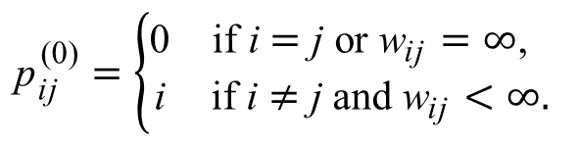
⎛
⎝
⎞
⎠
0 | 3 | 8 | ∞ | −4
∞ | 0 | ∞ | 1 | 7
∞ | 4 | 0 | ∞ | ∞
2 | ∞ | −5 | 0 | ∞
∞ | ∞ | ∞ | 6 | 0
D⁽⁰⁾ =
void FloydWarshall( int n )
{
for( int i = 1; i <= n; i++ )
for( int j = 1; j <= n; j++ )
d[0][i][j] = w[i][j];
for( int i = 1; i <= n; i++ )
for( int j = 1; j <= n; j++ )
if( i == j || w[i][j] == INT_MAX )
p[0][i][j] = 0;
else
p[0][i][j] = i;
⎛
⎝
⎞
⎠
0 | 1 | 1 | 0 | 1
0 | 0 | 0 | 2 | 2
0 | 3 | 0 | 0 | 0
4 | 0 | 4 | 0 | 0
0 | 0 | 0 | 5 | 0
Π⁽⁰⁾ =
$${\text{p}}_{\text{i}\text{j}}^{ \text{(0)}}=\left\{\begin{matrix}\text{0} & \text{if} \text{i}=\text{j} \text{or} {\text{w}}_{\text{i}\text{j}}=∞\text{, } \\ \text{i} & \text{if} \text{i}≠\text{j} \text{and} {\text{w}}_{\text{i}\text{j}}<∞.\end{matrix}\right.$$

Slide 34
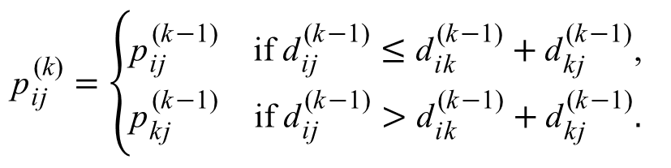
for( int k = 1; k <= n; k++ )
for( int i = 1; i <= n; i++ )
for( int j = 1; j <= n; j++ )
if( d[k-1][i][j] > d[k-1][i][k] + d[k-1][k][j] )
{
d[k][i][j] = d[k-1][i][k] + d[k-1][k][j];
p[k][i][j] = p[k-1][k][j];
}
else
{
d[k][i][j] = d[k-1][i][j];
p[k][i][j] = p[k-1][i][j];
}
$${\text{p}}_{\text{i}\text{j}}^{ \text{(}\text{k}\text{)}}=\left\{\begin{matrix}{\text{p}}_{\text{i}\text{j}}^{ \text{(}\text{k}\text{−}\text{1}\text{)}} & \text{if} {\text{d}}_{\text{i}\text{j}}^{ \text{(}\text{k}\text{−}\text{1}\text{)}}≤{\text{d}}_{\text{i}\text{k}}^{ \text{(}\text{k}\text{−}\text{1}\text{)}}+{\text{d}}_{\text{k}\text{j}}^{ \text{(}\text{k}\text{−}\text{1}\text{)}}\text{,} \\ {\text{p}}_{\text{k}\text{j}}^{ \text{(}\text{k}\text{−}\text{1}\text{)}} & \text{if} {\text{d}}_{\text{i}\text{j}}^{ \text{(}\text{k}\text{−}\text{1}\text{)}}>{\text{d}}_{\text{i}\text{k}}^{ \text{(}\text{k}\text{−}\text{1}\text{)}}+{\text{d}}_{\text{k}\text{j}}^{ \text{(}\text{k}\text{−}\text{1}\text{)}}.\end{matrix}\right.$$

Slide 35
⎛
⎝
⎞
⎠
⎛
⎝
⎞
⎠
0 | 3 | 8 | 4 | −4
∞ | 0 | ∞ | 1 | 7
∞ | 4 | 0 | 5 | 11
2 | −1 | −5 | 0 | −2
∞ | ∞ | ∞ | 6 | 0
NIL | 1 | 1 | 2 | 1
NIL | NIL | NIL | 2 | 2
NIL | 3 | NIL | 2 | 2
4 | 3 | 4 | NIL | 1
NIL | NIL | NIL | 5 | NIL
D⁽³⁾ =
Π⁽³⁾ =
⎛
⎝
⎞
⎠
⎛
⎝
⎞
⎠
0 | 3 | −1 | 4 | −4
3 | 0 | −4 | 1 | −1
7 | 4 | 0 | 5 | 3
2 | −1 | −5 | 0 | −2
8 | 5 | 1 | 6 | 0
NIL | 1 | 4 | 2 | 1
4 | NIL | 4 | 2 | 1
4 | 3 | NIL | 2 | 1
4 | 3 | 4 | NIL | 1
4 | 3 | 4 | 5 | NIL
D⁽⁴⁾ =
Π⁽⁴⁾ =
if( d[k-1][3][5] > d[k-1][3][k] + d[k-1][k][5] )
{
d[k][3][5] = d[k-1][3][k] + d[k-1][k][5];
p[k][3][5] = p[k-1][k][5];
}
k = 4

Slide 36
⎛
⎝
⎞
⎠
⎛
⎝
⎞
⎠
0 | 3 | 8 | 4 | −4
∞ | 0 | ∞ | 1 | 7
∞ | 4 | 0 | 5 | 11
2 | −1 | −5 | 0 | −2
∞ | ∞ | ∞ | 6 | 0
NIL | 1 | 1 | 2 | 1
NIL | NIL | NIL | 2 | 2
NIL | 3 | NIL | 2 | 2
4 | 3 | 4 | NIL | 1
NIL | NIL | NIL | 5 | NIL
D⁽³⁾ =
Π⁽³⁾ =
⎛
⎝
⎞
⎠
⎛
⎝
⎞
⎠
0 | 3 | −1 | 4 | −4
3 | 0 | −4 | 1 | −1
7 | 4 | 0 | 5 | 3
2 | −1 | −5 | 0 | −2
8 | 5 | 1 | 6 | 0
NIL | 1 | 4 | 2 | 1
4 | NIL | 4 | 2 | 1
4 | 3 | NIL | 2 | 1
4 | 3 | 4 | NIL | 1
4 | 3 | 4 | 5 | NIL
D⁽⁴⁾ =
Π⁽⁴⁾ =
if( d[k-1][2][5] > d[k-1][2][k] + d[k-1][k][5] )
{
d[k][2][5] = d[k-1][2][k] + d[k-1][k][5];
p[k][2][5] = p[k-1][k][5];
}
k = 4

Slide 37
⎛
⎝
⎞
⎠
⎛
⎝
⎞
⎠
0 | 3 | 8 | ∞ | −4
∞ | 0 | ∞ | 1 | 7
∞ | 4 | 0 | ∞ | ∞
2 | ∞ | −5 | 0 | ∞
∞ | ∞ | ∞ | 6 | 0
NIL | 1 | 1 | NIL | 1
NIL | NIL | NIL | 2 | 2
NIL | 3 | NIL | NIL | NIL
4 | NIL | 4 | NIL | NIL
NIL | NIL | NIL | 5 | NIL
D⁽⁰⁾ =
Π⁽⁰⁾ =
⎛
⎝
⎞
⎠
⎛
⎝
⎞
⎠
0 | 3 | 8 | ∞ | −4
∞ | 0 | ∞ | 1 | 7
∞ | 4 | 0 | ∞ | ∞
2 | 5 | −5 | 0 | −2
∞ | ∞ | ∞ | 6 | 0
NIL | 1 | 1 | NIL | 1
NIL | NIL | NIL | 2 | 2
NIL | 3 | NIL | NIL | NIL
4 | 1 | 4 | NIL | 1
NIL | NIL | NIL | 5 | NIL
D⁽¹⁾ =
Π⁽¹⁾ =
⎛
⎝
⎞
⎠
⎛
⎝
⎞
⎠
0 | 3 | 8 | 4 | −4
∞ | 0 | ∞ | 1 | 7
∞ | 4 | 0 | 5 | 11
2 | 5 | −5 | 0 | −2
∞ | ∞ | ∞ | 6 | 0
NIL | 1 | 1 | 2 | 1
NIL | NIL | NIL | 2 | 2
NIL | 3 | NIL | 2 | 2
4 | 1 | 4 | NIL | 1
NIL | NIL | NIL | 5 | NIL
D⁽²⁾ =
Π⁽²⁾ =

Slide 38
⎛
⎝
⎞
⎠
⎛
⎝
⎞
⎠
0 | 3 | 8 | 4 | −4
∞ | 0 | ∞ | 1 | 7
∞ | 4 | 0 | 5 | 11
2 | −1 | −5 | 0 | −2
∞ | ∞ | ∞ | 6 | 0
NIL | 1 | 1 | 2 | 1
NIL | NIL | NIL | 2 | 2
NIL | 3 | NIL | 2 | 2
4 | 3 | 4 | NIL | 1
NIL | NIL | NIL | 5 | NIL
D⁽³⁾ =
Π⁽³⁾ =
⎛
⎝
⎞
⎠
⎛
⎝
⎞
⎠
0 | 3 | −1 | 4 | −4
3 | 0 | −4 | 1 | −1
7 | 4 | 0 | 5 | 3
2 | −1 | −5 | 0 | −2
8 | 5 | 1 | 6 | 0
NIL | 1 | 4 | 2 | 1
4 | NIL | 4 | 2 | 1
4 | 3 | NIL | 2 | 1
4 | 3 | 4 | NIL | 1
4 | 3 | 4 | 5 | NIL
D⁽⁴⁾ =
Π⁽⁴⁾ =
⎛
⎝
⎞
⎠
⎛
⎝
⎞
⎠
0 | 1 | −3 | 2 | −4
3 | 0 | −4 | 1 | −1
7 | 4 | 0 | 5 | 3
2 | −1 | −5 | 0 | −2
8 | 5 | 1 | 6 | 0
NIL | 3 | 4 | 5 | 1
4 | NIL | 4 | 2 | 1
4 | 3 | NIL | 2 | 1
4 | 3 | 4 | NIL | 1
4 | 3 | 4 | 5 | NIL
D⁽⁵⁾ =
Π⁽⁵⁾ =

Slide 39
void FloydWarshall( int n )
{
for( int i = 1; i <= n; i++ )
for( int j = 1; j <= n; j++ )
d[0][i][j] = w[i][j];
for( int i = 1; i <= n; i++ )
for( int j = 1; j <= n; j++ )
if( i == j || w[i][j] == INT_MAX )
p[0][i][j] = 0;
else
p[0][i][j] = i;
for( int k = 1; k <= n; k++ )
for( int i = 1; i <= n; i++ )
for( int j = 1; j <= n; j++ )
if( d[k-1][i][j] > d[k-1][i][k] + d[k-1][k][j] )
{
d[k][i][j] = d[k-1][i][k] + d[k-1][k][j];
p[k][i][j] = p[k-1][k][j];
}
else
{
d[k][i][j] = d[k-1][i][j];
p[k][i][j] = p[k-1][i][j];
}
}

Slide 40
void FloydWarshall( int n )
{
for( int i = 1; i <= n; i++ )
for( int j = 1; j <= n; j++ )
d[i][j] = w[i][j];
for( int i = 1; i <= n; i++ )
for( int j = 1; j <= n; j++ )
if( i == j || w[i][j] == INT_MAX )
p[i][j] = 0;
else
p[i][j] = i;
for( int k = 1; k <= n; k++ )
for( int i = 1; i <= n; i++ )
for( int j = 1; j <= n; j++ )
if( d[i][j] > d[i][k] + d[k][j] )
{
d[i][j] = d[i][k] + d[k][j];
p[i][j] = p[k][j];
}
else
{
d[i][j] = d[i][j];
p[i][j] = p[i][j];
}
}

Slide 41
Finding the Diameter of a Graph
The diameter of a graph is defined as the maximum shortest path distance between any pair of nodes of that graph.
2
3
4
⎛
⎝
⎞
⎠
0 | 1 | −3 | 2 | −4
3 | 0 | −4 | 1 | −1
7 | 4 | 0 | 5 | 3
2 | −1 | −5 | 0 | −2
8 | 5 | 1 | 6 | 0
1
3
8
1
−4
2
−5
7
5
4
6

Slide 42
Finding the Diameter of a Graph
The diameter of a graph is defined as the maximum shortest path distance between any pair of nodes of that graph.
void findDiameter( int n )
{
for( int i = 1; i <= n; i++ )
for( int j = 1; j <= n; j++ )
d[i][j] = w[i][j];
for( int k = 1; k <= n; k++ )
for( int i = 1; i <= n; i++ )
for( int j = 1; j <= n; j++ )
d[i][j] = min( d[i][j], d[i][k] + d[k][j] );
int diameter = 0;
for( int i = 1; i <= n; i++ )
for( int j = 1; j <= n; j++ )
if( diameter < d[i][j] )
diameter = d[i][j];
return diameter;
}

Slide 43
Transitive Closure of a Directed Graph
Given a directed graph G = (V, E) with node set V = {1, 2, ..., n}, we might wish to determine whether G contains a path from i to j for all node pairs i, j ∈ V. We define the transitive closure of G as the graph G∗ = (V, E∗), where
E∗ = {(i, j) : there is a path from node i to node j in G}.
1
2
1
2
4
3
4
3

Slide 44
Transitive Closure of a Relation
DEFINITION Let R be a relation on a set A. The smallest transitive relation that contains R is called the transitive closure of R.
DEFINITION Let R be a relation on a set A. The connectivity relation R∗ consists of the pairs (a, b) such that there is a path of length at least one from a to b in R.
THEOREM The transitive closure of a relation R equals the connectivity relation R∗.
Example: R = { (2, 3), (2, 4), (3, 2), (4, 1), (4, 3)}.
1
2
1
2
4
3
4
3

Slide 45
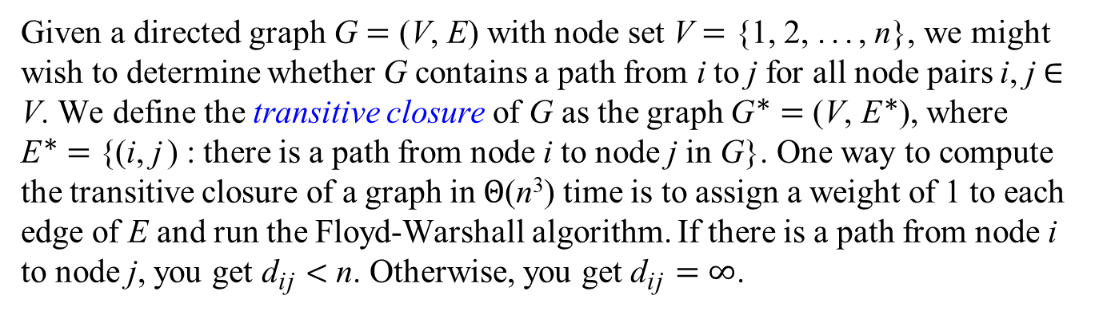
Transitive Closure of a Directed Graph
Given a directed graph G = (V, E) with node set V = {1, 2, ..., n}, we might wish to determine whether G contains a path from i to j for all node pairs i, j ∈ V. We define the transitive closure of G as the graph G∗ = (V, E∗), where
E∗ = {(i, j) : there is a path from node i to node j in G}. One way to compute the transitive closure of a graph in Θ(n³) time is to assign a weight of 1 to each edge of E and run the Floyd-Warshall algorithm. If there is a path from node i to node j, you get ${\text{d}}_{\text{i}\text{j}}$ < n. Otherwise, you get ${\text{d}}_{\text{i}\text{j}}$ = ∞.
1
2
1
2
4
3
4
3

Slide 46
1
2
⎛
⎝
⎞
⎠
0 | ∞ | ∞ | ∞
∞ | 0 | 1 | 1
∞ | 1 | 0 | ∞
1 | ∞ | 1 | 0
D⁽⁰⁾ =
4
3
⎛
⎝
⎞
⎠
⎛
⎝
⎞
⎠
0 | ∞ | ∞ | ∞
∞ | 0 | 1 | 1
∞ | 1 | 0 | ∞
1 | ∞ | 1 | 0
0 | ∞ | ∞ | ∞
∞ | 0 | 1 | 1
∞ | 1 | 0 | 2
1 | ∞ | 1 | 0
D⁽¹⁾ =
D⁽²⁾ =
⎛
⎝
⎞
⎠
⎛
⎝
⎞
⎠
0 | ∞ | ∞ | ∞
∞ | 0 | 1 | 1
∞ | 1 | 0 | 2
1 | 2 | 1 | 0
0 | ∞ | ∞ | ∞
2 | 0 | 1 | 1
3 | 1 | 0 | 2
1 | 2 | 1 | 0
D⁽³⁾ =
D⁽⁴⁾ =

Slide 47
1
2
4
3
⎛
⎝
⎞
⎠
⎛
⎝
⎞
⎠
1 | 0 | 0 | 0
1 | 1 | 1 | 1
1 | 1 | 1 | 1
1 | 1 | 1 | 1
0 | ∞ | ∞ | ∞
2 | 0 | 1 | 1
3 | 1 | 0 | 2
1 | 2 | 1 | 0
T⁽⁴⁾ =
D⁽⁴⁾ =

Slide 48

Transitive Closure of a Directed Graph
Given a directed graph G = (V, E) with node set V = {1, 2, ..., n}, we might wish to determine whether G contains a path from i to j for all node pairs i, j ∈ V. We define the transitive closure of G as the graph G∗ = (V, E∗), where
E∗ = {(i, j) : there is a path from node i to node j in G}.
For i, j, k = 1, 2, ..., n, we define ${\text{t}}_{\text{i}\text{j}}^{ \text{(}\text{k}\text{)}}$ to be 1 if there exists a path in graph G from node i to node j with all intermediate nodes in the set {1, 2, ..., k}, and 0 otherwise. We construct the transitive closure by putting edge (i, j) into E∗ if and only if ${\text{t}}_{\text{i}\text{j}}^{ \text{(}\text{n}\text{)}}$ = 1. A recursive definition of ${\text{t}}_{\text{i}\text{j}}^{ \text{(}\text{k}\text{)}}$ is
$${\text{t}}_{\text{i}\text{j}}^{ \text{(}\text{0}\text{)}}=\left\{\begin{matrix}\text{0} & \text{if} \text{i}≠\text{j} \text{and} \text{(}\text{i}\text{, }\text{j}\text{)}∉\text{E}\text{,} \\ \text{1} & \text{if} \text{i}=\text{j} \text{or} \text{(}\text{i}\text{, }\text{j}\text{)}∈\text{E}\text{, } \end{matrix}\right.$$
and for k ≥ 1,
$${\text{t}}_{\text{i}\text{j}}^{ \text{(}\text{k}\text{)}}={\text{t}}_{\text{i}\text{j}}^{ \text{(}\text{k}\text{−}\text{1}\text{)}} ⋁\left({\text{t}}_{\text{i}\text{k}}^{ \text{(}\text{k}\text{−}\text{1}\text{)}} ⋀ {\text{t}}_{\text{k}\text{j}}^{ \text{(}\text{k}\text{−}\text{1}\text{)}}\right).$$
1
2
4
3

Slide 49
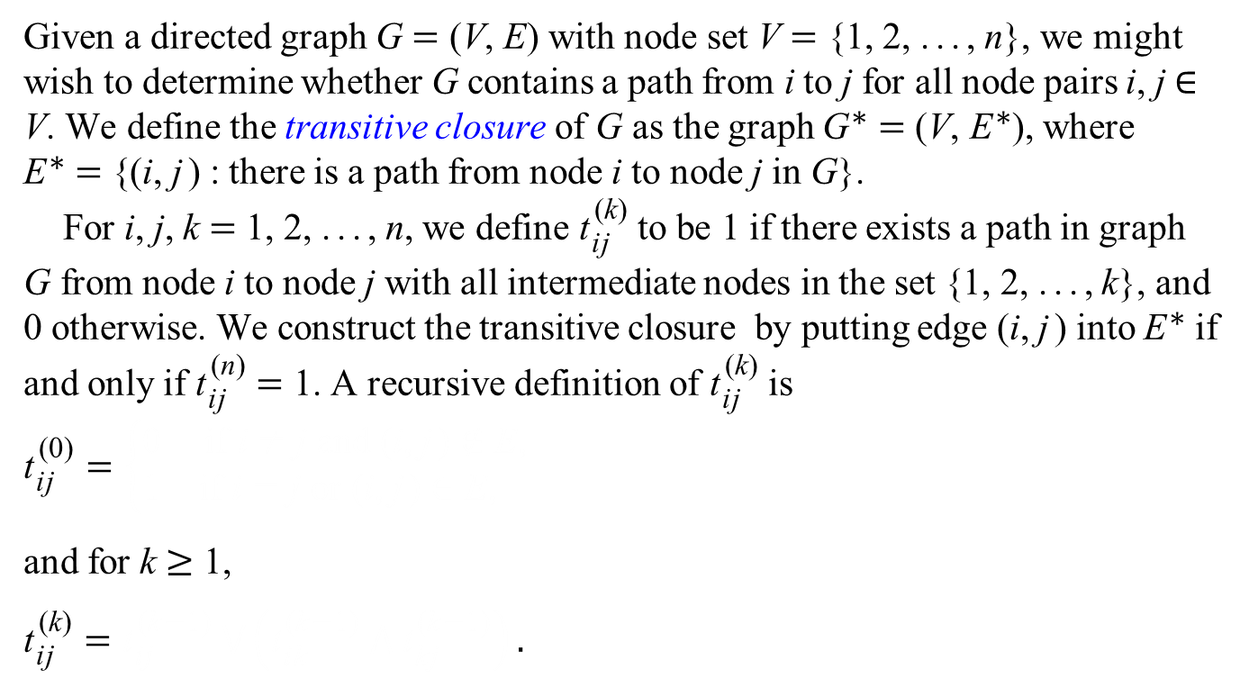
Transitive Closure of a Directed Graph
Given a directed graph G = (V, E) with node set V = {1, 2, ..., n}, we might wish to determine whether G contains a path from i to j for all node pairs i, j ∈ V. We define the transitive closure of G as the graph G∗ = (V, E∗), where
E∗ = {(i, j) : there is a path from node i to node j in G}.
For i, j, k = 1, 2, ..., n, we define ${\text{t}}_{\text{i}\text{j}}^{ \text{(}\text{k}\text{)}}$ to be 1 if there exists a path in graph G from node i to node j with all intermediate nodes in the set {1, 2, ..., k}, and 0 otherwise. We construct the transitive closure by putting edge (i, j) into E∗ if and only if ${\text{t}}_{\text{i}\text{j}}^{ \text{(}\text{n}\text{)}}$ = 1. A recursive definition of ${\text{t}}_{\text{i}\text{j}}^{ \text{(}\text{k}\text{)}}$ is
$${\text{t}}_{\text{i}\text{j}}^{ \text{(}\text{0}\text{)}}=\left\{\begin{matrix}\text{0} & \text{if} \text{i}≠\text{j} \text{and} \text{(}\text{i}\text{, }\text{j}\text{)}∉\text{E}\text{,} \\ \text{1} & \text{if} \text{i}=\text{j} \text{or} \text{(}\text{i}\text{, }\text{j}\text{)}∈\text{E}\text{, } \end{matrix}\right.$$
and for k ≥ 1,
$${\text{t}}_{\text{i}\text{j}}^{ \text{(}\text{k}\text{)}}={\text{t}}_{\text{i}\text{j}}^{ \text{(}\text{k}\text{−}\text{1}\text{)}} ⋁\left({\text{t}}_{\text{i}\text{k}}^{ \text{(}\text{k}\text{−}\text{1}\text{)}} ⋀ {\text{t}}_{\text{k}\text{j}}^{ \text{(}\text{k}\text{−}\text{1}\text{)}}\right).$$
1
2
4
3

Slide 50
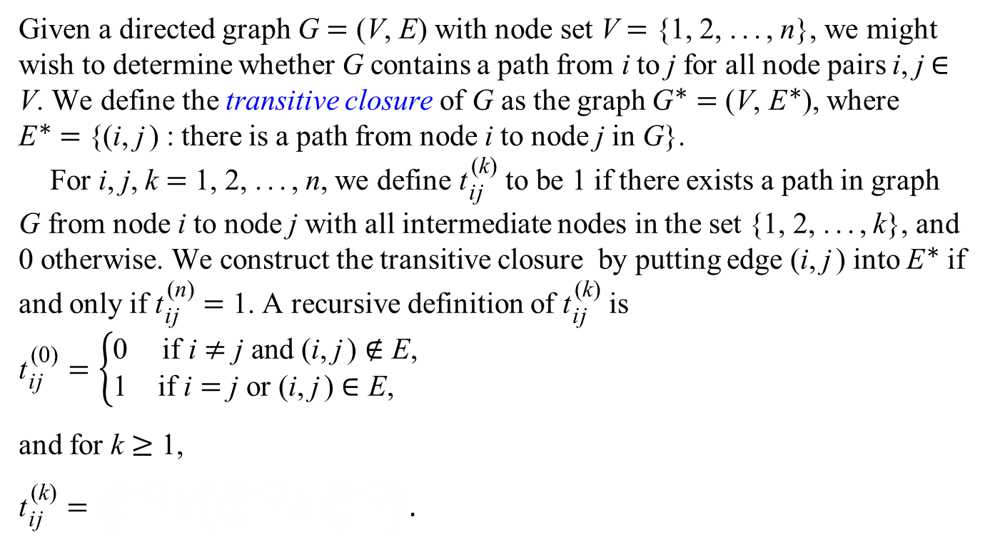
Transitive Closure of a Directed Graph
Given a directed graph G = (V, E) with node set V = {1, 2, ..., n}, we might wish to determine whether G contains a path from i to j for all node pairs i, j ∈ V. We define the transitive closure of G as the graph G∗ = (V, E∗), where
E∗ = {(i, j) : there is a path from node i to node j in G}.
For i, j, k = 1, 2, ..., n, we define ${\text{t}}_{\text{i}\text{j}}^{ \text{(}\text{k}\text{)}}$ to be 1 if there exists a path in graph G from node i to node j with all intermediate nodes in the set {1, 2, ..., k}, and 0 otherwise. We construct the transitive closure by putting edge (i, j) into E∗ if and only if ${\text{t}}_{\text{i}\text{j}}^{ \text{(}\text{n}\text{)}}$ = 1. A recursive definition of ${\text{t}}_{\text{i}\text{j}}^{ \text{(}\text{k}\text{)}}$ is
$${\text{t}}_{\text{i}\text{j}}^{ \text{(}\text{0}\text{)}}=\left\{\begin{matrix}\text{0} & \text{if} \text{i}≠\text{j} \text{and} \text{(}\text{i}\text{, }\text{j}\text{)}∉\text{E}\text{,} \\ \text{1} & \text{if} \text{i}=\text{j} \text{or} \text{(}\text{i}\text{, }\text{j}\text{)}∈\text{E}\text{, } \end{matrix}\right.$$
and for k ≥ 1,
$${\text{t}}_{\text{i}\text{j}}^{ \text{(}\text{k}\text{)}}={\text{t}}_{\text{i}\text{j}}^{ \text{(}\text{k}\text{−}\text{1}\text{)}} ⋁\left({\text{t}}_{\text{i}\text{k}}^{ \text{(}\text{k}\text{−}\text{1}\text{)}} ⋀ {\text{t}}_{\text{k}\text{j}}^{ \text{(}\text{k}\text{−}\text{1}\text{)}}\right).$$
1
2
4
3

Slide 51
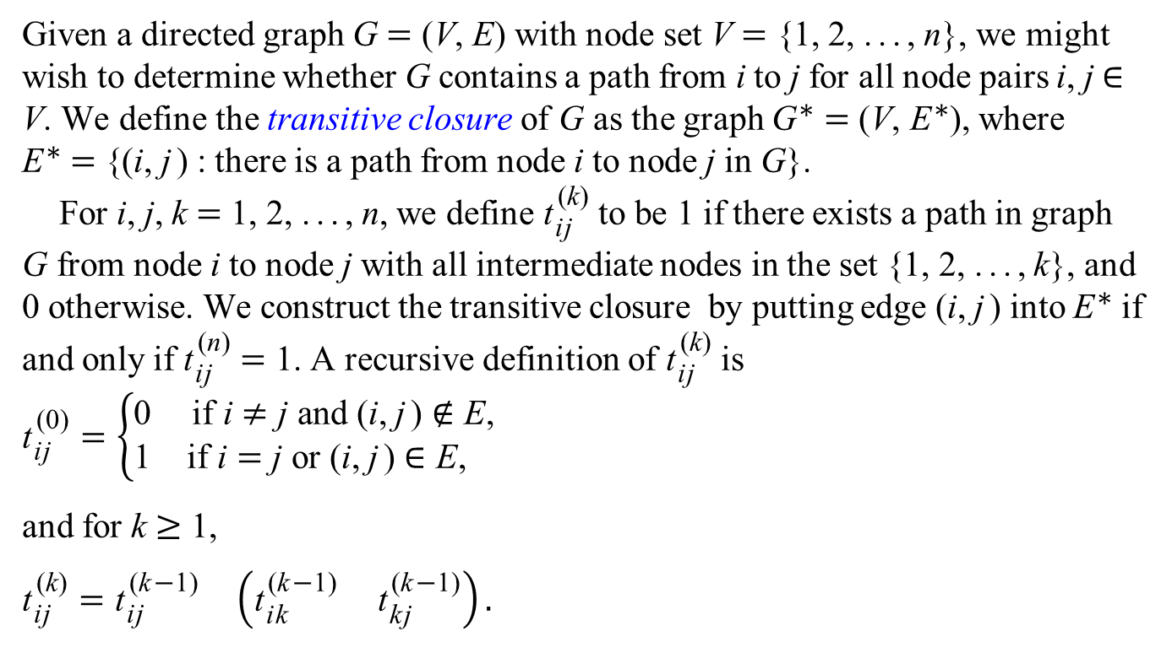
Transitive Closure of a Directed Graph
Given a directed graph G = (V, E) with node set V = {1, 2, ..., n}, we might wish to determine whether G contains a path from i to j for all node pairs i, j ∈ V. We define the transitive closure of G as the graph G∗ = (V, E∗), where
E∗ = {(i, j) : there is a path from node i to node j in G}.
For i, j, k = 1, 2, ..., n, we define ${\text{t}}_{\text{i}\text{j}}^{ \text{(}\text{k}\text{)}}$ to be 1 if there exists a path in graph G from node i to node j with all intermediate nodes in the set {1, 2, ..., k}, and 0 otherwise. We construct the transitive closure by putting edge (i, j) into E∗ if and only if ${\text{t}}_{\text{i}\text{j}}^{ \text{(}\text{n}\text{)}}$ = 1. A recursive definition of ${\text{t}}_{\text{i}\text{j}}^{ \text{(}\text{k}\text{)}}$ is
$${\text{t}}_{\text{i}\text{j}}^{ \text{(}\text{0}\text{)}}=\left\{\begin{matrix}\text{0} & \text{if} \text{i}≠\text{j} \text{and} \text{(}\text{i}\text{, }\text{j}\text{)}∉\text{E}\text{,} \\ \text{1} & \text{if} \text{i}=\text{j} \text{or} \text{(}\text{i}\text{, }\text{j}\text{)}∈\text{E}\text{, } \end{matrix}\right.$$
and for k ≥ 1,
$${\text{t}}_{\text{i}\text{j}}^{ \text{(}\text{k}\text{)}}={\text{t}}_{\text{i}\text{j}}^{ \text{(}\text{k}\text{−}\text{1}\text{)}} ⋁\left({\text{t}}_{\text{i}\text{k}}^{ \text{(}\text{k}\text{−}\text{1}\text{)}} ⋀ {\text{t}}_{\text{k}\text{j}}^{ \text{(}\text{k}\text{−}\text{1}\text{)}}\right).$$
1
2
4
3

Slide 52
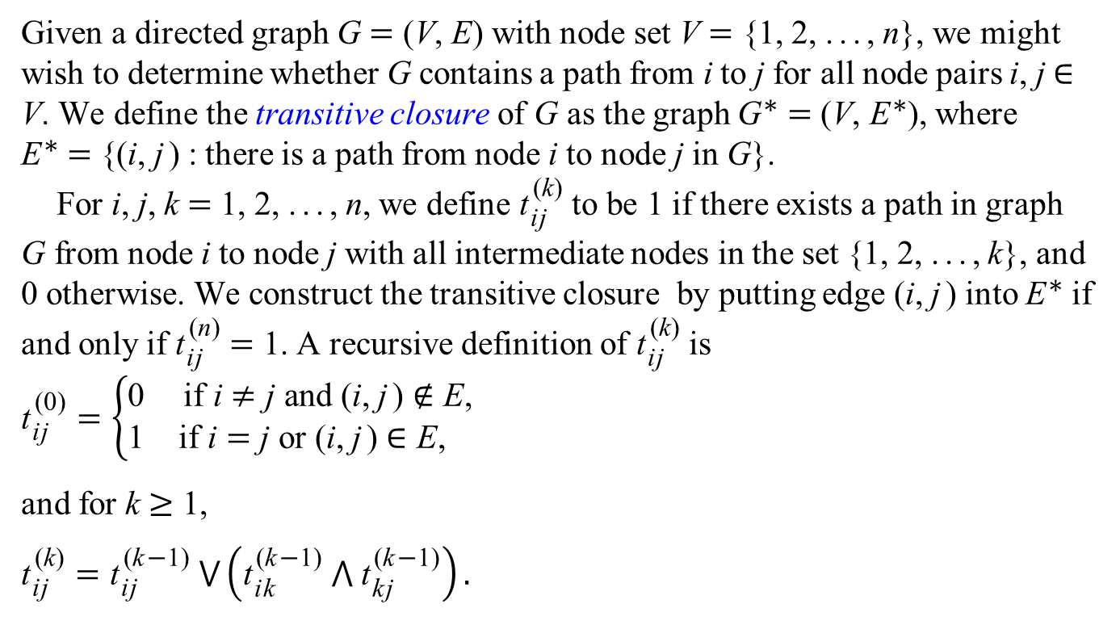
Transitive Closure of a Directed Graph
Given a directed graph G = (V, E) with node set V = {1, 2, ..., n}, we might wish to determine whether G contains a path from i to j for all node pairs i, j ∈ V. We define the transitive closure of G as the graph G∗ = (V, E∗), where
E∗ = {(i, j) : there is a path from node i to node j in G}.
For i, j, k = 1, 2, ..., n, we define ${\text{t}}_{\text{i}\text{j}}^{ \text{(}\text{k}\text{)}}$ to be 1 if there exists a path in graph G from node i to node j with all intermediate nodes in the set {1, 2, ..., k}, and 0 otherwise. We construct the transitive closure by putting edge (i, j) into E∗ if and only if ${\text{t}}_{\text{i}\text{j}}^{ \text{(}\text{n}\text{)}}$ = 1. A recursive definition of ${\text{t}}_{\text{i}\text{j}}^{ \text{(}\text{k}\text{)}}$ is
$${\text{t}}_{\text{i}\text{j}}^{ \text{(}\text{0}\text{)}}=\left\{\begin{matrix}\text{0} & \text{if} \text{i}≠\text{j} \text{and} \text{(}\text{i}\text{, }\text{j}\text{)}∉\text{E}\text{,} \\ \text{1} & \text{if} \text{i}=\text{j} \text{or} \text{(}\text{i}\text{, }\text{j}\text{)}∈\text{E}\text{, } \end{matrix}\right.$$
and for k ≥ 1,
$${\text{t}}_{\text{i}\text{j}}^{ \text{(}\text{k}\text{)}}={\text{t}}_{\text{i}\text{j}}^{ \text{(}\text{k}\text{−}\text{1}\text{)}} ⋁\left({\text{t}}_{\text{i}\text{k}}^{ \text{(}\text{k}\text{−}\text{1}\text{)}} ⋀ {\text{t}}_{\text{k}\text{j}}^{ \text{(}\text{k}\text{−}\text{1}\text{)}}\right).$$
1
2
4
3

Slide 53
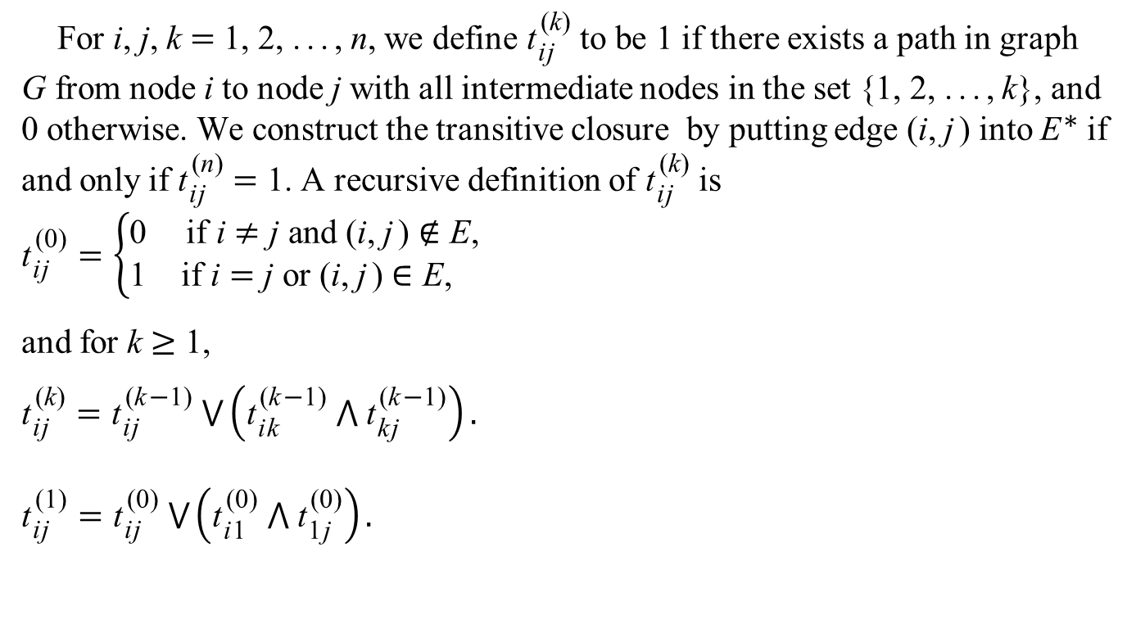
Transitive Closure of a Directed Graph
For i, j, k = 1, 2, ..., n, we define ${\text{t}}_{\text{i}\text{j}}^{ \text{(}\text{k}\text{)}}$ to be 1 if there exists a path in graph G from node i to node j with all intermediate nodes in the set {1, 2, ..., k}, and 0 otherwise. We construct the transitive closure by putting edge (i, j) into E∗ if and only if ${\text{t}}_{\text{i}\text{j}}^{ \text{(}\text{n}\text{)}}$ = 1. A recursive definition of ${\text{t}}_{\text{i}\text{j}}^{ \text{(}\text{k}\text{)}}$ is
$${\text{t}}_{\text{i}\text{j}}^{ \text{(}\text{0}\text{)}}=\left\{\begin{matrix}\text{0} & \text{if} \text{i}≠\text{j} \text{and} \text{(}\text{i}\text{, }\text{j}\text{)}∉\text{E}\text{,} \\ \text{1} & \text{if} \text{i}=\text{j} \text{or} \text{(}\text{i}\text{, }\text{j}\text{)}∈\text{E}\text{, } \end{matrix}\right.$$
and for k ≥ 1,
$${\text{t}}_{\text{i}\text{j}}^{ \text{(}\text{k}\text{)}}={\text{t}}_{\text{i}\text{j}}^{ \text{(}\text{k}\text{−}\text{1}\text{)}} ⋁\left({\text{t}}_{\text{i}\text{k}}^{ \text{(}\text{k}\text{−}\text{1}\text{)}} ⋀ {\text{t}}_{\text{k}\text{j}}^{ \text{(}\text{k}\text{−}\text{1}\text{)}}\right).$$
$${\text{t}}_{\text{i}\text{j}}^{ \text{(}\text{1}\text{)}}={\text{t}}_{\text{i}\text{j}}^{ \text{(}\text{0}\text{)}} ⋁\left({\text{t}}_{\text{i}\text{1}}^{ \text{(}\text{0}\text{)}} ⋀ {\text{t}}_{\text{1}\text{j}}^{ \text{(}\text{0}\text{)}}\right).$$
1
2
4
3

Slide 54
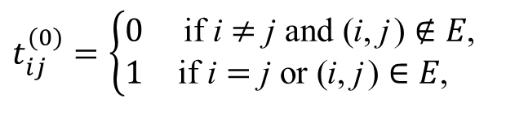

Transitive Closure of a Directed Graph
$$t_{ij}^{(0)}=\left\{\begin{matrix}0 & \text{if} \text{i}≠\text{j} \text{and} \text{(}\text{i}\text{, }\text{j}\text{)}∉E\text{,} \\ 1 & \text{if} \text{i}=\text{j} \text{or}\text{ (}\text{i}\text{, }\text{j}\text{)}∈E\text{, } \end{matrix}\right.$$
void TransitiveClosure( int n )
{
for( int i = 1; i <= n; i++ )
for( int j = 1; j <= n; j++ )
if( i == j || adjMatrix[ i ][ j ] )
t[ 0 ][ i ][ j ] = 1;
else
t[ 0 ][ i ][ j ] = 0;
for( int k = 1; k <= n; k++ )
for( int i = 1; i <= n; i++ )
for( int j = 1; j <= n; j++ )
t[ k ][ i ][ j ] = t[ k - 1 ][ i ][ j ] ||
( t[ k - 1 ][ i ][ k ] &&
t[ k - 1 ][ k ][ j ] );
}
$$t_{ij}^{(k)}=t_{ij}^{(k−1)} ⋁\left(t_{ik}^{\left(k−1\right)} ⋀ t_{kj}^{\left(k−1\right)}\right)$$

Slide 55
1
2
⎛
⎝
⎞
⎠
1 | 0 | 0 | 0
0 | 1 | 1 | 1
0 | 1 | 1 | 0
1 | 0 | 1 | 1
T⁽⁰⁾ =
4
3
⎛
⎝
⎞
⎠
⎛
⎝
⎞
⎠
1 | 0 | 0 | 0
0 | 1 | 1 | 1
0 | 1 | 1 | 0
1 | 0 | 1 | 1
1 | 0 | 0 | 0
0 | 1 | 1 | 1
0 | 1 | 1 | 1
1 | 0 | 1 | 1
T⁽¹⁾ =
T⁽²⁾ =
⎛
⎝
⎞
⎠
⎛
⎝
⎞
⎠
1 | 0 | 0 | 0
0 | 1 | 1 | 1
0 | 1 | 1 | 1
1 | 1 | 1 | 1
1 | 0 | 0 | 0
1 | 1 | 1 | 1
1 | 1 | 1 | 1
1 | 1 | 1 | 1
T⁽³⁾ =
T⁽⁴⁾ =

Slide 56

Transitive Closure of a Directed Graph
void TransitiveClosure( int n )
{
for( int i = 1; i <= n; i++ )
for( int j = 1; j <= n; j++ )
if( i == j || adjMatrix[ i ][ j ] )
t[ i ][ j ] = 1;
else
t[ i ][ j ] = 0;
for( int k = 1; k <= n; k++ )
for( int i = 1; i <= n; i++ )
for( int j = 1; j <= n; j++ )
t[ i ][ j ] = t[ i ][ j ] ||
( t[ i ][ k ] && t[ k ][ j ] );
}
$${\text{t}}_{\text{i}\text{j}}^{ \text{(}\text{k}\text{)}}={\text{t}}_{\text{i}\text{j}}^{ \text{(}\text{k}\text{−}\text{1}\text{)}} ⋁\left({\text{t}}_{\text{i}\text{k}}^{ \text{(}\text{k}\text{−}\text{1}\text{)}} ⋀ {\text{t}}_{\text{k}\text{j}}^{ \text{(}\text{k}\text{−}\text{1}\text{)}}\right)$$

Slide 57
The Floyd-Warshall Algorithm
void FloydWarshall( int n )
{
for( int i = 1; i <= n; i++ )
for( int j = 1; j <= n; j++ )
d[i][j] = w[i][j];
for( int k = 1; k <= n; k++ )
for( int i = 1; i <= n; i++ )
for( int j = 1; j <= n; j++ )
d[i][j] = min( d[i][j], d[i][k] + d[k][j] );
}
$${\text{d}}_{\text{i}\text{j}}^{ \text{(}\text{k}\text{)}}=\left\{\begin{matrix}{\text{w}}_{\text{i}\text{j}} & \text{if} \text{k}=\text{0,} \\ \text{min}\left({\text{d}}_{\text{i}\text{j}}^{ \text{(}\text{k}\text{−}\text{1}\text{)}}\text{, }{\text{d}}_{\text{i}\text{k}}^{ \text{(}\text{k}\text{−}\text{1}\text{)}}+{\text{d}}_{\text{k}\text{j}}^{ \text{(}\text{k}\text{−}\text{1}\text{)}}\right) & \text{if} \text{k}≥\text{1}\text{.}\end{matrix}\right.$$

Slide 58
Minimax and Maximin
The minimax path problem is a problem of finding the minimum of maximum edge weight among all possible paths from node i to node j. The cost for a path from i to j is determined by the maximum edge weight along this path. Among all these possible paths from i to j, pick the one with the minimum max-edge-weight. The reverse problem of maximum is defined similarly.
2
3
4
⎛
⎝
⎞
⎠
0 | 3 | 6 | 3 | −4
1 | 0 | 1 | 1 | 7
1 | 4 | 0 | 4 | 4
2 | 4 | −5 | 0 | 2
6 | 6 | 6 | 6 | 0
1
3
8
1
−4
2
−5
7
5
4
6

Slide 59
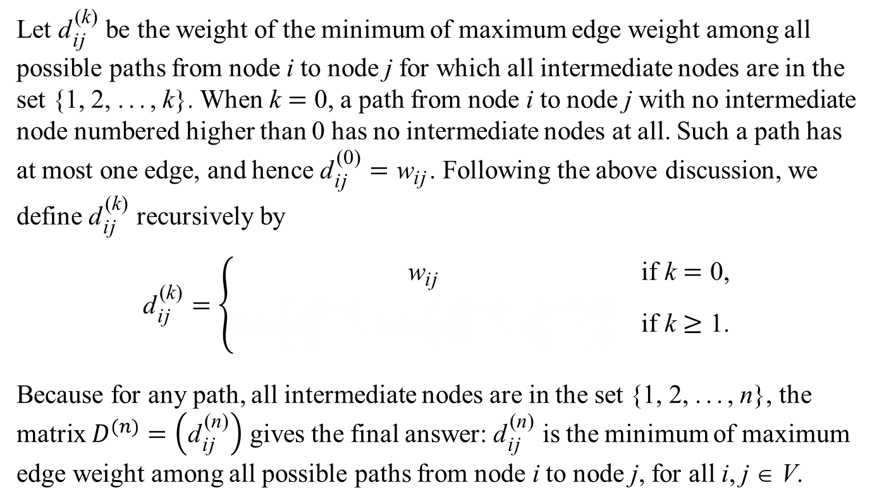
Minimax and Maximin
Let ${\text{d}}_{\text{i}\text{j}}^{ \text{(}\text{k}\text{)}}$ be the weight of the minimum of maximum edge weight among all possible paths from node i to node j for which all intermediate nodes are in the set {1, 2, ..., k}. When k = 0, a path from node i to node j with no intermediate node numbered higher than 0 has no intermediate nodes at all. Such a path has at most one edge, and hence ${\text{d}}_{\text{i}\text{j}}^{ \text{(0)}}={\text{w}}_{\text{i}\text{j}}$. Following the above discussion, we define ${\text{d}}_{\text{i}\text{j}}^{ \text{(}\text{k}\text{)}}$ recursively by
$${\text{d}}_{\text{i}\text{j}}^{ \text{(}\text{k}\text{)}}=\left\{\begin{matrix}{\text{w}}_{\text{i}\text{j}} & \text{if} \text{k}=\text{0,} \\ \text{min}\left({\text{d}}_{\text{i}\text{j}}^{ \text{(}\text{k}\text{−}\text{1}\text{)}}\text{, }\text{max}\left({\text{d}}_{\text{i}\text{k}}^{ \text{(}\text{k}\text{−}\text{1}\text{)}}\text{, }{\text{d}}_{\text{k}\text{j}}^{ \text{(}\text{k}\text{−}\text{1}\text{)}}\right)\right) & \text{if} \text{k}≥\text{1}\text{.}\end{matrix}\right.$$
Because for any path, all intermediate nodes are in the set {1, 2, ..., n}, the matrix $D^{(n)}=\left({\text{d}}_{\text{i}\text{j}}^{ \text{(}\text{n}\text{)}}\right)$ gives the final answer: ${\text{d}}_{\text{i}\text{j}}^{ \text{(}\text{n}\text{)}}$ is the minimum of maximum edge weight among all possible paths from node i to node j, for all i, j ∈ V.

Slide 60
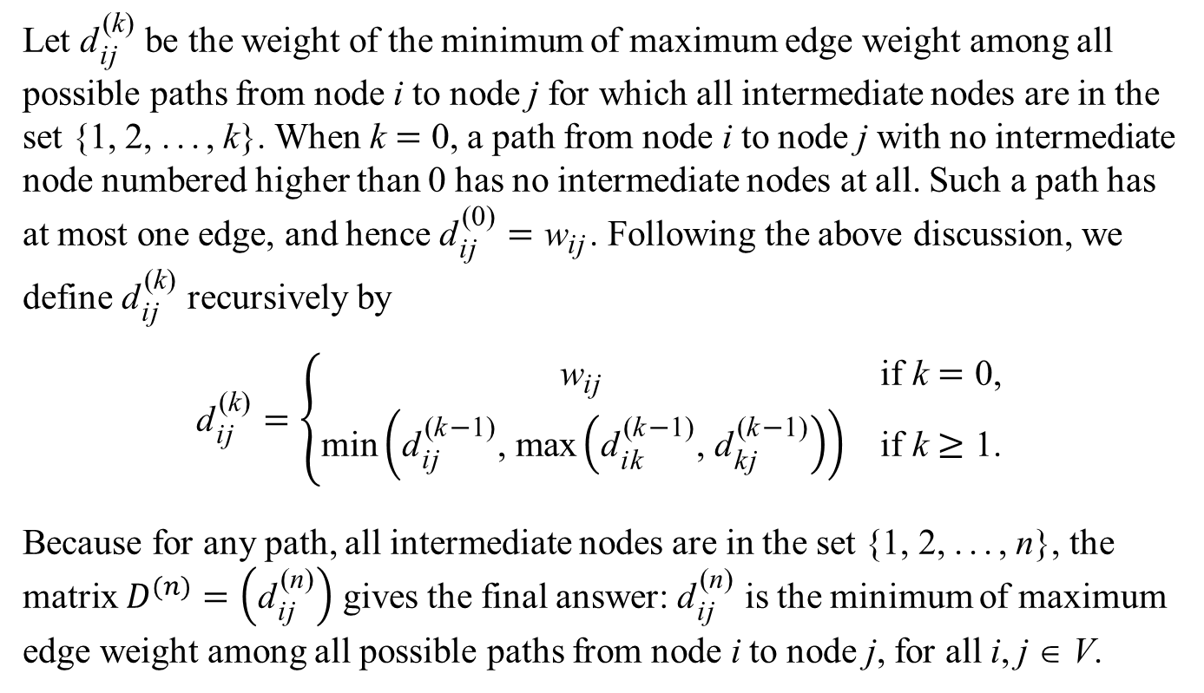
Minimax and Maximin
Let ${\text{d}}_{\text{i}\text{j}}^{ \text{(}\text{k}\text{)}}$ be the weight of the minimum of maximum edge weight among all possible paths from node i to node j for which all intermediate nodes are in the set {1, 2, ..., k}. When k = 0, a path from node i to node j with no intermediate node numbered higher than 0 has no intermediate nodes at all. Such a path has at most one edge, and hence ${\text{d}}_{\text{i}\text{j}}^{ \text{(0)}}={\text{w}}_{\text{i}\text{j}}$. Following the above discussion, we define ${\text{d}}_{\text{i}\text{j}}^{ \text{(}\text{k}\text{)}}$ recursively by
$${\text{d}}_{\text{i}\text{j}}^{ \text{(}\text{k}\text{)}}=\left\{\begin{matrix}{\text{w}}_{\text{i}\text{j}} & \text{if} \text{k}=\text{0,} \\ \text{min}\left({\text{d}}_{\text{i}\text{j}}^{ \text{(}\text{k}\text{−}\text{1}\text{)}}\text{, }\text{max}\left({\text{d}}_{\text{i}\text{k}}^{ \text{(}\text{k}\text{−}\text{1}\text{)}}\text{, }{\text{d}}_{\text{k}\text{j}}^{ \text{(}\text{k}\text{−}\text{1}\text{)}}\right)\right) & \text{if} \text{k}≥\text{1}\text{.}\end{matrix}\right.$$
Because for any path, all intermediate nodes are in the set {1, 2, ..., n}, the matrix $D^{(n)}=\left({\text{d}}_{\text{i}\text{j}}^{ \text{(}\text{n}\text{)}}\right)$ gives the final answer: ${\text{d}}_{\text{i}\text{j}}^{ \text{(}\text{n}\text{)}}$ is the minimum of maximum edge weight among all possible paths from node i to node j, for all i, j ∈ V.

Slide 61
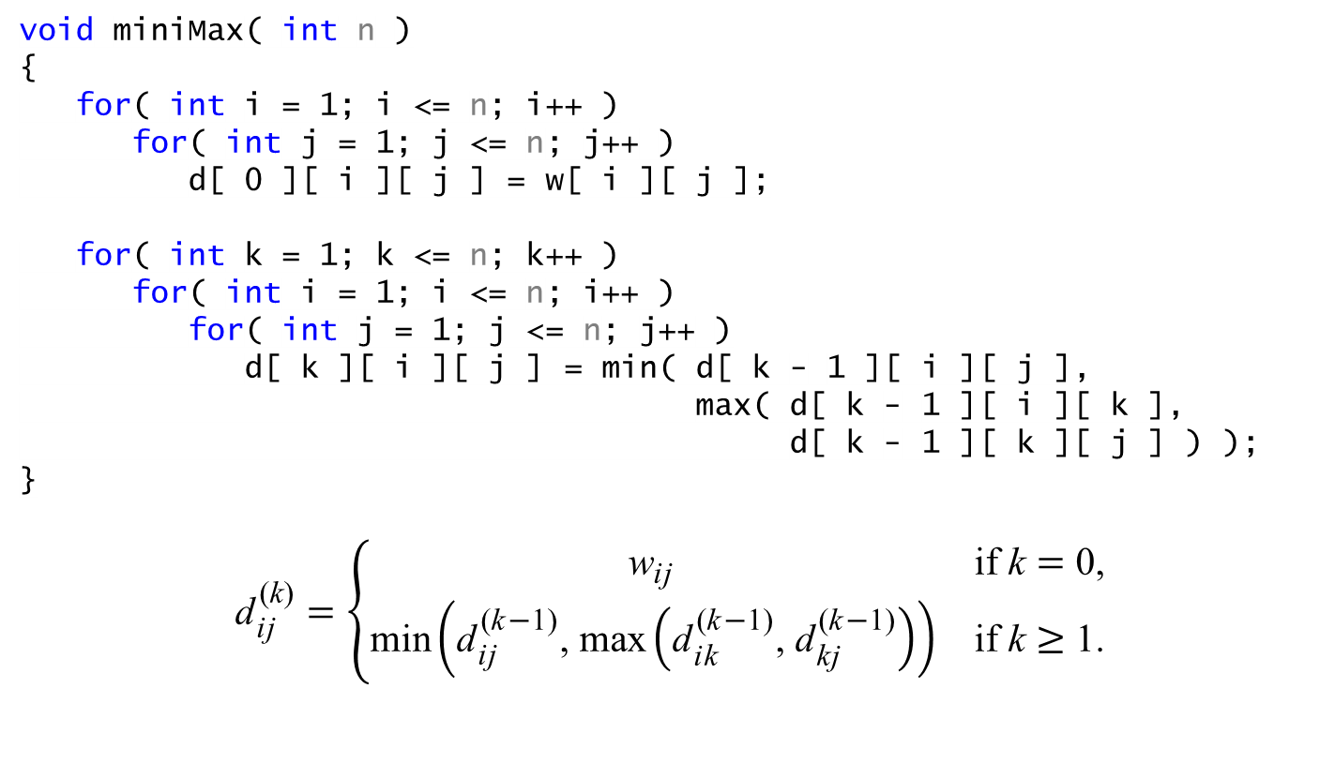
Minimax and Maximin
void miniMax( int n )
{
for( int i = 1; i <= n; i++ )
for( int j = 1; j <= n; j++ )
d[ 0 ][ i ][ j ] = w[ i ][ j ];
for( int k = 1; k <= n; k++ )
for( int i = 1; i <= n; i++ )
for( int j = 1; j <= n; j++ )
d[ k ][ i ][ j ] = min( d[ k - 1 ][ i ][ j ],
max( d[ k - 1 ][ i ][ k ],
d[ k - 1 ][ k ][ j ] ) );
}
$${\text{d}}_{\text{i}\text{j}}^{ \text{(}\text{k}\text{)}}=\left\{\begin{matrix}{\text{w}}_{\text{i}\text{j}} & \text{if} \text{k}=\text{0,} \\ \text{min}\left({\text{d}}_{\text{i}\text{j}}^{ \text{(}\text{k}\text{−}\text{1}\text{)}}\text{, }\text{max}\left({\text{d}}_{\text{i}\text{k}}^{ \text{(}\text{k}\text{−}\text{1}\text{)}}\text{, }{\text{d}}_{\text{k}\text{j}}^{ \text{(}\text{k}\text{−}\text{1}\text{)}}\right)\right) & \text{if} \text{k}≥\text{1}\text{.}\end{matrix}\right.$$

Slide 62
Minimax and Maximin
void miniMax( int n )
{
for( int i = 1; i <= n; i++ )
for( int j = 1; j <= n; j++ )
d[ i ][ j ] = w[ i ][ j ];
for( int k = 1; k <= n; k++ )
for( int i = 1; i <= n; i++ )
for( int j = 1; j <= n; j++ )
d[ i ][ j ] = min( d[ i ][ j ],
max( d[ i ][ k ], d[ k ][ j ] ) );
}

